Slide 1
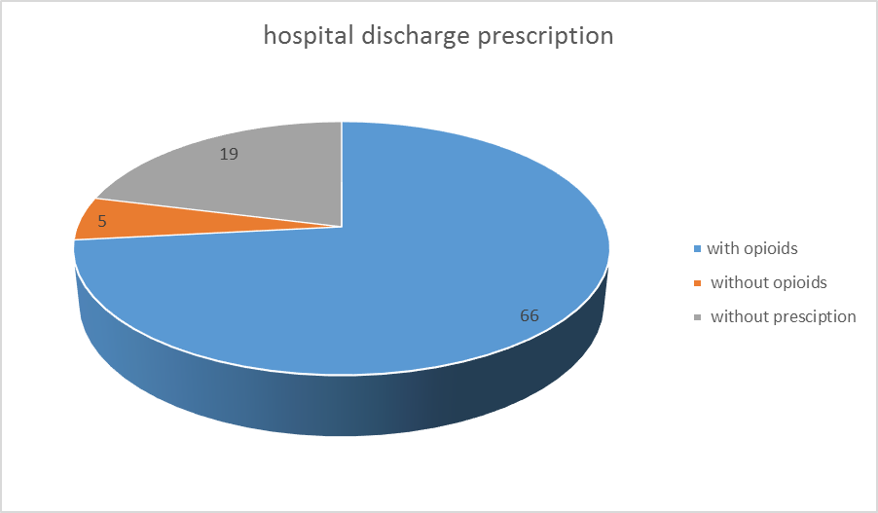
Post Surgical Discharge Prescription of Opioids: Who is Watching? Athanasia Chatziperi , Alison Blackburn, Sailesh Mishra* Royal Victoria Infirmary, Newcastle upon Tyne
Background
Opioids remain the mainstay for the management of moderate to severe postoperative pain. In selected patient groups, treatment with opioids may need to continue for a variable period of time after discharge.
By the 1940s, opioids were so tightly restricted that they could be used legally only when they were prescribed strictly by physicians only. Consequently, there was reluctance to prescribe opioids, and globally for decades, pain was undertreated.
Over the last 30 years, the use of opioids to manage acute pain has regained its place in accepted medical practice. The WHO promoted pain as the "fifth vital sign" with the intent of swinging the pendulum back to appropriately treating patients pain.
Aim
This survey aimed to identify the magnitude of the inappropriate postoperative discharge prescribing of opioids by the hospital doctors. It also aimed to identify the role of the GP in optimizing and monitoring postoperative opioid prescribing. The overall goal of this research was to identify the size of the problem of inappropriate opioid prescribing at discharge from the hospital and on subsequent follow-up.
Conclusion
The use and efficacy of opioid for management of post surgical pain in the community after discharge from hospital is debatable.
Inappropriate use of opioids for longer than intended period of use is associated with the well recognized problems of endocrine and immunological side effects and risks of addiction.
Clear discharge instructions regarding the intended period of opioid use for post surgical pain and subsequent timely review by GP for continued need for opioids and side effects assessments is a joint responsibility.
More awareness and communications among hospital doctors and GP is warranted to address this issue of inappropriate post surgical opioid use.
More focused education and development of a national guidance for monitoring post surgical opioid use will be effective in bringing about a safer opioid prescribing practice.
Method
We prospectively selected 90 patients who underwent general, gynecological or orthopedic procedures between 01/04/2015 and 01/05/2015.
Patients on preexisting opioid medications and those under 18 yrs. of age were excluded from the study.
We reviewed patient’s hospital discharge letter and discharge prescriptions using the electronic patient record keeping system (e records) in our Trust.
We then sent letters to the patients’ GP , requesting information regarding their ongoing prescriptions 1 month following the discharge from the hospital. The GP had option to respond with a fax, email or a letter in a prepaid envelope that was included in our requesting letter.

