Slide 1
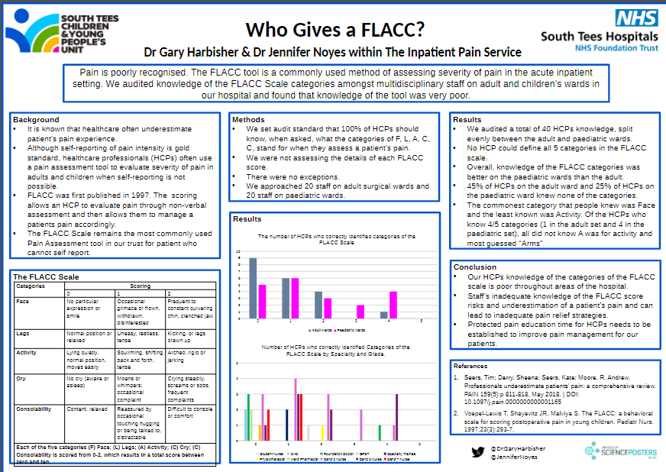

Slide 2
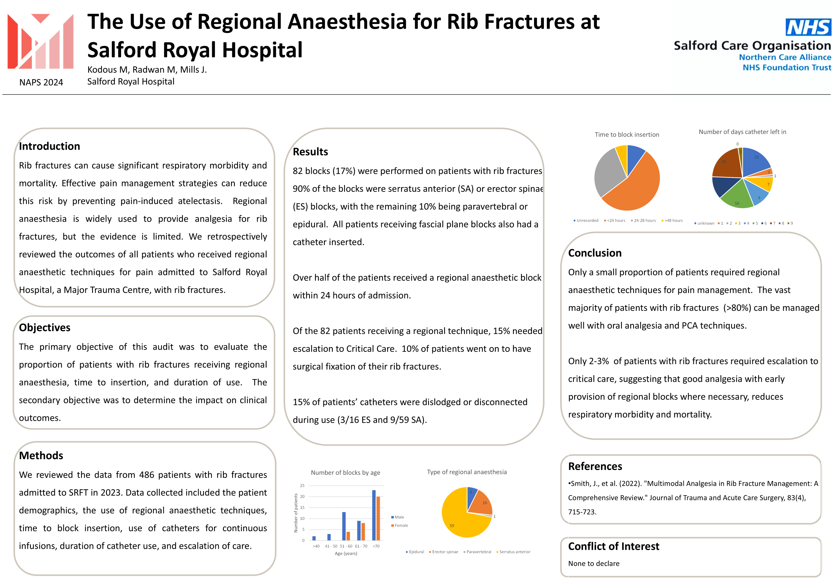


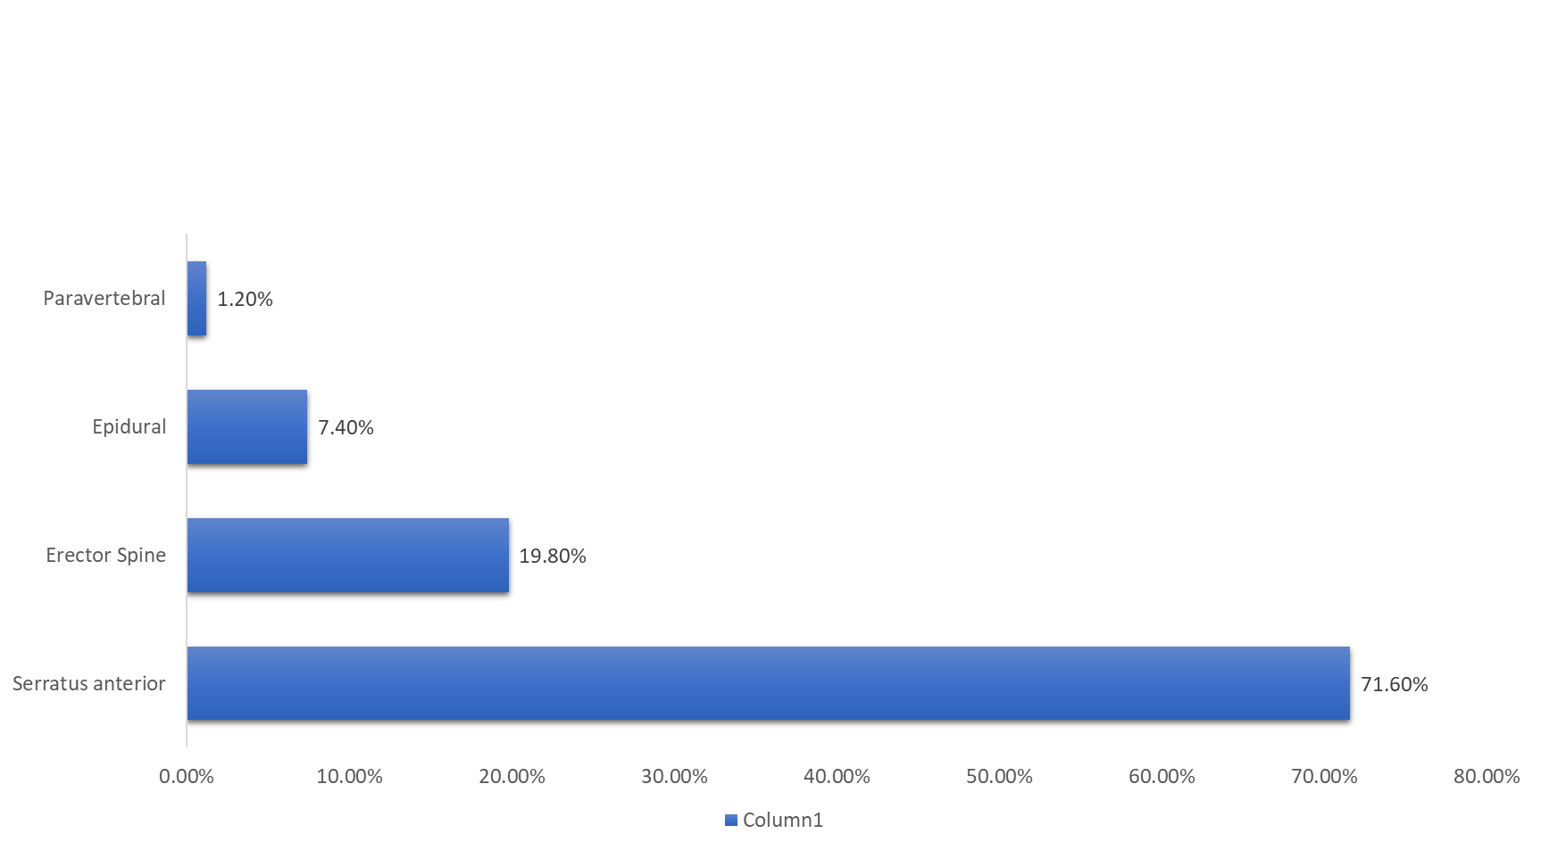
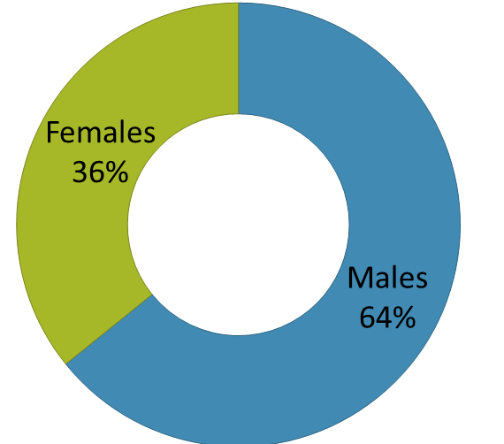
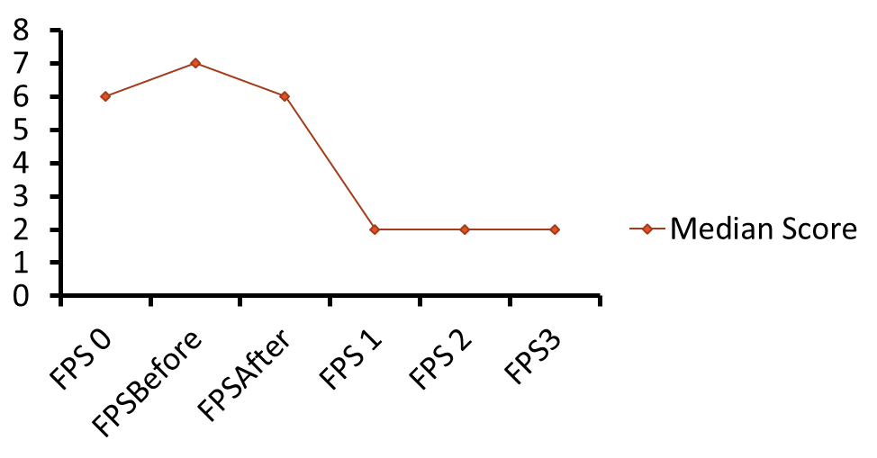
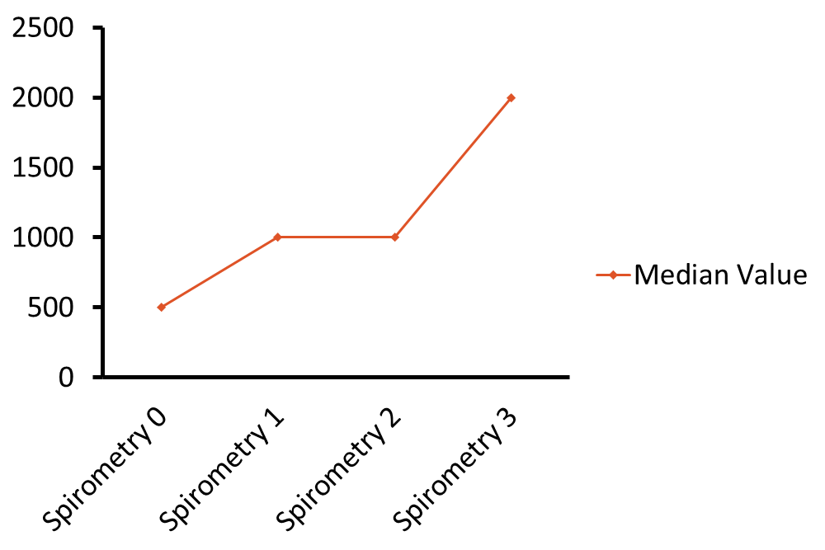
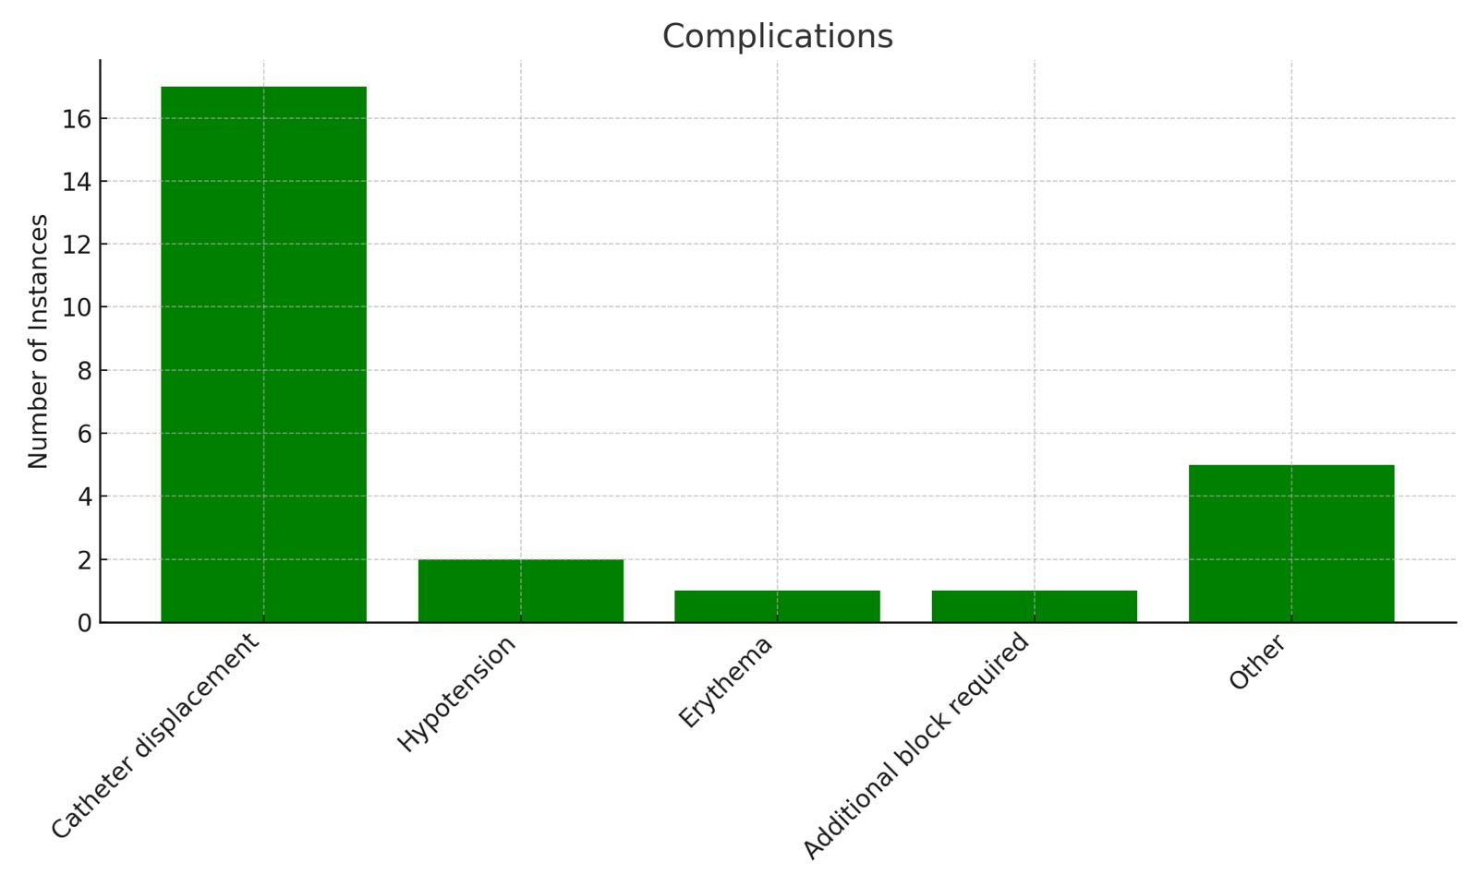
The Use of Regional Anaesthesia for Rib Fractures at Salford Royal Hospital
Kodous M, Radwan M, Mills J.
Salford Royal Hospital
NAPS 2024
Conclusion
A total of 86 blocks were performed on patients with rib fractures. Note: There is a significant amount of missing data in the FPS and spirometry sections. Although the data we have is positive, it is incomplete.
The audit highlights the utilisation of regional anaesthesia in rib fracture management at SRFT. The limited data we had demonstrated benefits in both FPS and spirometry.
Recommendations
We recommend the current early referral for pain services to review the need for a block. The data we have suggests the blocks are effective, however the a prospective audit would be better to ensure complete data collection given the quantity of missing data we have.
References
Smith, J., et al. (2022). "Multimodal Analgesia in Rib Fracture Management: A Comprehensive Review." Journal of Trauma and Acute Care Surgery, 83(4), 715-723.
Conflict of Interest
None to declare
Introduction
Salford Royal Hospital (SRFT) is a major trauma centre which admitted 486 patients with rib fractures in 2023. All patients with rib fractures are reviewed within 24 hours of admission by the pain team. Rib fractures are associated with significant morbidity and mortality, necessitating effective pain management strategies. Regional anaesthesia, particularly nerve blocks, are used for their efficacy in managing pain thus improving patient outcomes. This retrospective audit reviews the outcomes of regional anaesthesia in patients with rib fractures at SRFT.
Objectives
The primary objective of this audit was to evaluate the proportion of rib fracture patients receiving regional anaesthesia and their impact on pain scores and clinical outcomes. Secondary objectives included assessing the duration and complications of catheter use and the effects on spirometry results.
Methods
A retrospective analysis was conducted on 486 patients with rib fractures admitted to SRFT. Data collected included patient usage of nerve blocks, pain scores, spirometry results and clinical outcomes. Pain scores were measured using Functional Pain Scores (FPS) at various time points: on first contact, immediately before the block, on the same day after the block, and on days 1, 2, and 3 post-block. These scores are measure ability to deep breath, cough and mobilise, regardless of the presence of absence of pain. Spirometry results were also recorded.
Results
Fig1 :Demographics
Fig2: Block utilization
*Morphine, Codeine, Entonox, ibuprofenfentanyl, oxycodone, aspirin
Fig3 : Functional Pain Scores
Fig 4. Spirometry
Fig5 : Complications

Slide 3
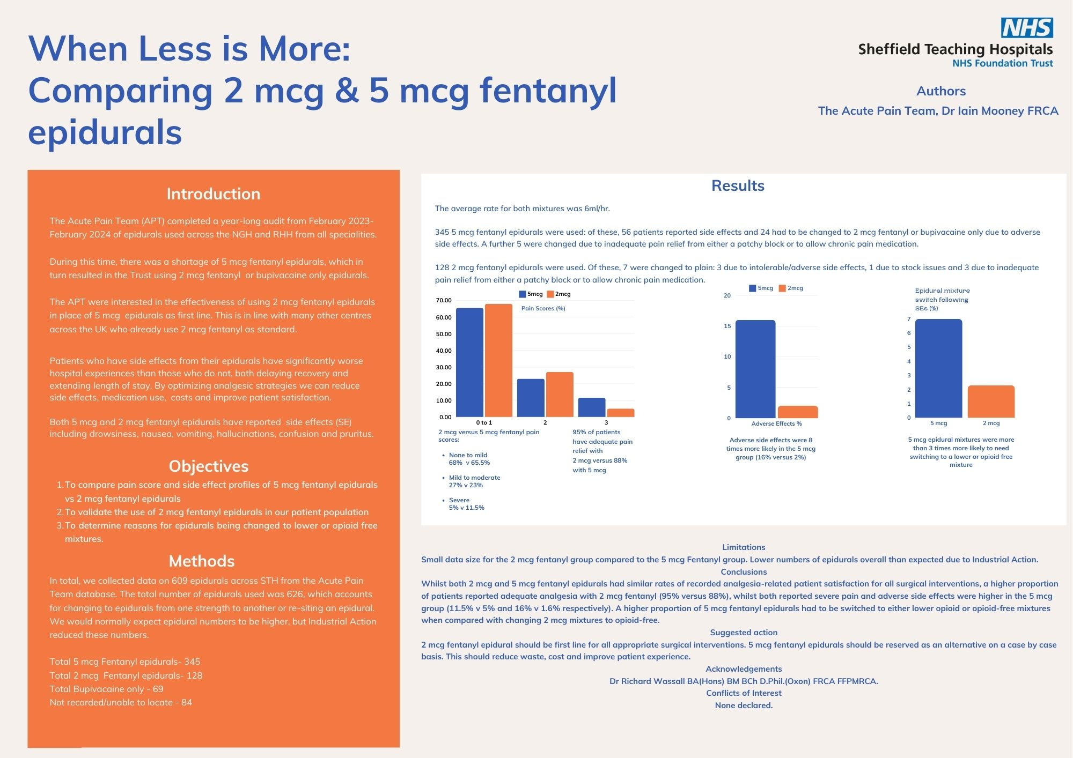

Slide 4
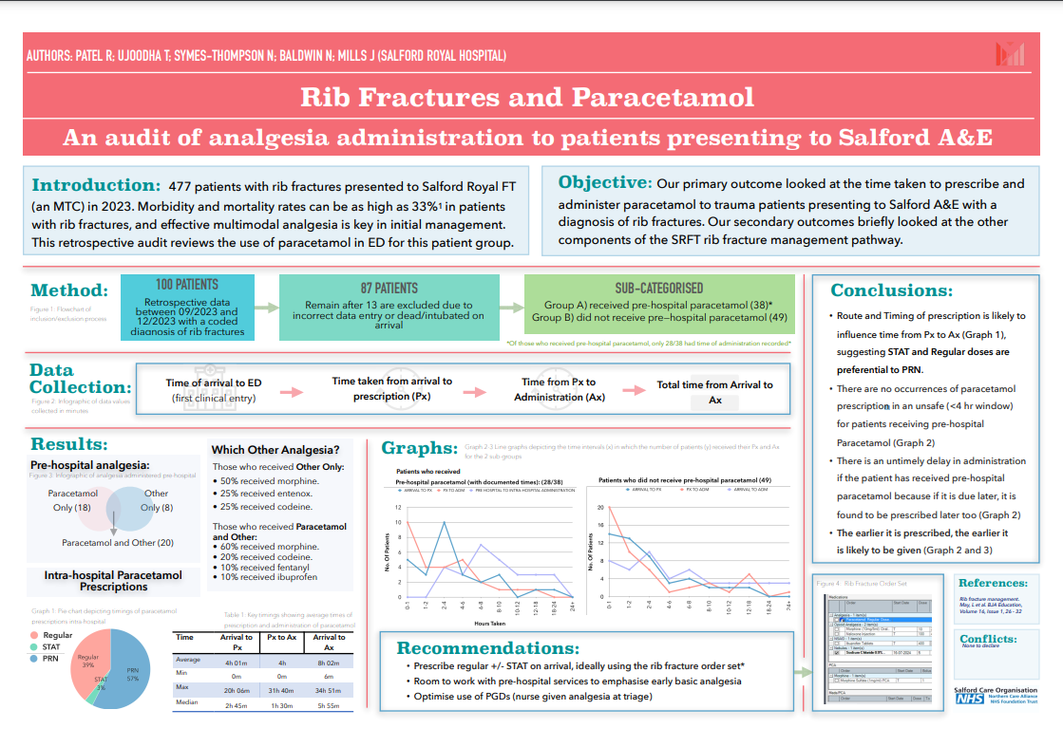

Slide 5




Compliance with Epidural PCA and Opioid PCA
Dr Gary Harbisher & Dr Lisa Molus within The Inpatient Pain Service
@DrGaryHarbisher
For patient safety, centres must ensure that we comply with local and national guidance on the care of patients with epidural PCAs and morphine and fentanyl PCAs. Our snapshot audit demonstrated clear areas for improvement in our centre. Our trusts forthcoming move to electronic prescribing may improve compliance.
Background
The Faculty of Pain medicine has produced clear guidance on how epidurals are managed on the ward.
Additionally, we have local guidance pertaining to the ward-based management of morphine and fentanyl Patient Controlled Analgesia (PCA)s.
Result Summary
Observation Frequency
Observations
Documented Daily Pain Team Review
100% compliance with audit standard
Prescription Completion
Epidural Removal
Audit Standards | Standard (%) | Result (%)
Observations frequency | 100 | 14.2 - 90%
Observations | 100 | 70 – 90%
Documented Pain Review | 100 | 100%
Prescription completion | 100 | 80 – 91.6%
Epidural Removal | 100 | 90 - 100%
 | Epidural | PCA
Prescription, Signed & Checked | 80% | 91.6%
Audit Standards
Observations frequency – Standard: 100%. Exceptions: Nil
  Intrathecal opioid and PCA - hrly for 12 hours, 2hrly for 12 hours, 4 hourly minimum
  Morphine or Fentanyl PCA - hrly for 6 hours, 4 hourly minimum
  Epidural - hrly for 12 hrs, 4 hourly minimum
Observations – Standard: 100%. Exceptions: Nil
  pain score, rate, total infused, respiration rate, 02 saturations, sedation score, Nausea and vomiting score, sensory level and bromage.
  pain score on rest and movement, demands / good, total doses and signed
Documented acute pain review – Standard: 100%. Exceptions: Nil
Prescription completion – Standard: 100%. Exceptions: Nil
  signed and checked
  rate set, solution indicated, rate, bolus, off cycle, prescribers signature, programmers signature, checked by signature
Epidural removal – Standard: 100%. Exceptions: Nil
  over 12 hours since LMWH - or under advice of haematology for other blood thinners
  Bromage score recorded within 2 hours of removal
Over 12 Hours since last LMWH | 100%
Bromage recorded within 2 hours removal | 90%
IT Opioid and PCA | Hourly for 12 hours | 21.4%
 | 2 Hourly for 12 hours | 14.2%
 | 4 Hourly minimum | 35.7%
PCA alone | Hourly for 6 hours | 50%
 | 4 Hourly minimum | 70%
Epidural | Hourly for 12 hours | 50%
 | 4 Hourly minimum | 90%
Results
In total we reviewed the care plans of 10 patients with epidurals, 24 opioid PCA patients (10 without intrathecal and 14 with intrathecal opioids)
Patients were found throughout critical care (paediatric critical care unit, general critical care unit, ICU2 and ICU3), and 7 surgical wards.
 | PCA | Epidural
Pain Score | 75% | 70%
Rate/ Demands/Good | 87.5% | 90%
Total Infused | 87.5% | 90%
Resp Rate | 79.1% | 80%
O2 Sats | 79.1% | 70%
Sedation Score | 83.3% | 70%
N&V Score | 79.1% | 90%
Sensory Level | NA | 60%
Bromage Score | NA | 70%
Conclusion
Frequency, completion and accuracy of observations are lacking for patients receiving epidural, or PCA
Without adequate training, patients receive suboptimal care and are at increased risk of complications.
As we move to electronic prescribing, we hope that compliance with mandated observations will improve.
Methods
Audit department approval was sought and obtained.
We conducted a snapshot audit of practice between 22nd May 2023 and 19th June 2023
All patients that had Epidurals or Opioid PCAs were included during this time had data collected across adult and paediatric settings, including critical care.
References
Faculty of Pain Medicine (2020) Best practice in the management of epidural analgesia in the hospital setting. Available at: https://fpm.ac.uk/sites/fpm/files/documents/2020-09/Epidural-AUG-2020-FINAL.pdf (Accessed: 01 April 2023).

Slide 6
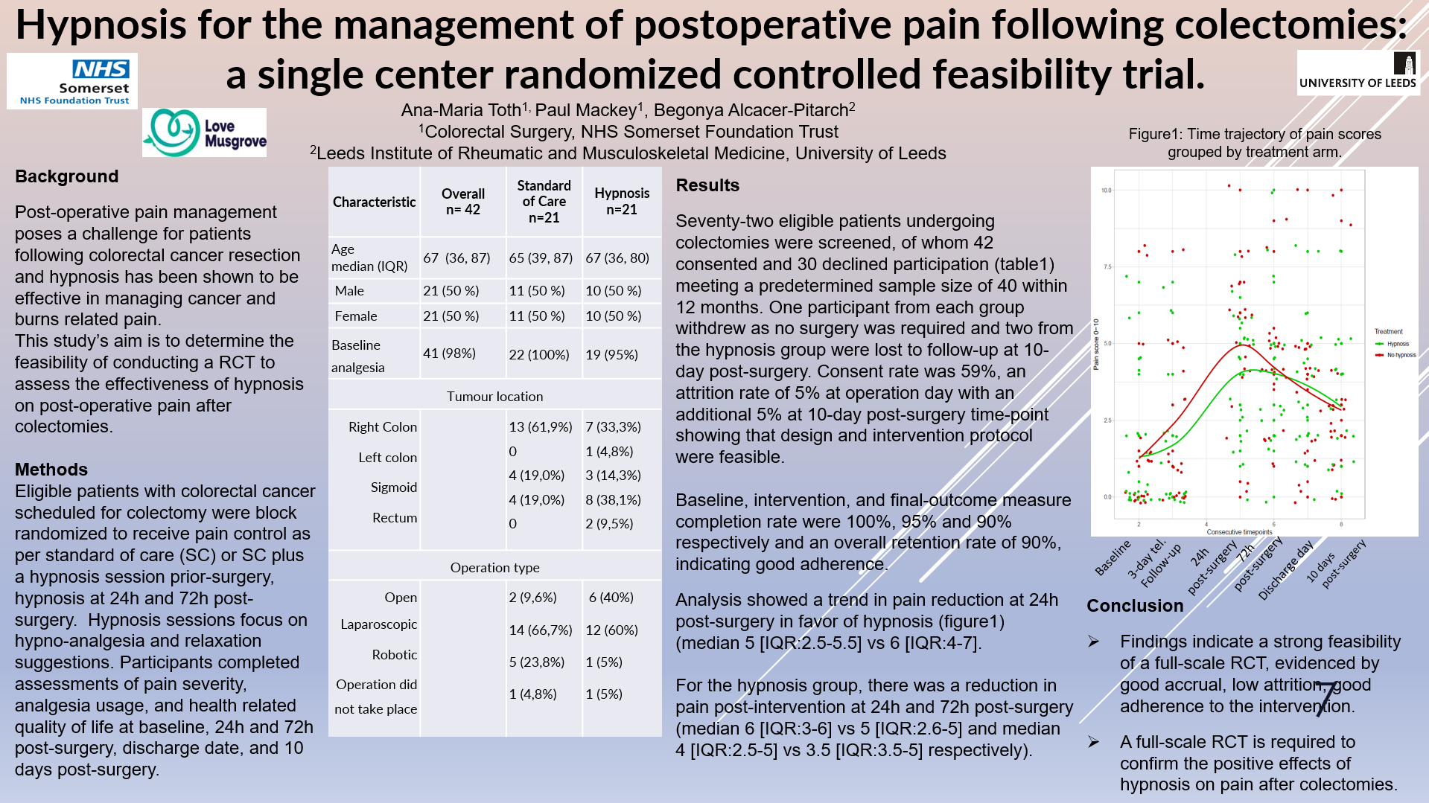

Slide 7
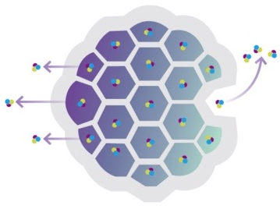

Liposomal Bupivacaine use in VATS Lobectomy
Dr Anya Sheltawy, Dr Amit Jaiswal, Dr Anurodh Bhawani
Liverpool Heart and Chest Hospital
Introduction
Thoracic surgery is commonly associated with post operative pain.⁽¹⁾ Effective analgesia has been shown to lower incidence of respiratory complications, and lower readmission to ICU. ⁽²⁾ Reduction in pain may decrease length of stay and improve patient satisfaction. 10-35% of video assisted thoracostomy (VAT) patients have chronic post thoracotomy pain syndrome (CPSP) ⁽³⁾
Liposomal bupivacaine is presented as a depo foam drug delivery system with multivesicular liposomes, containing bupivacaine (concentration on 13.3 mg/ml). After injection, the drug is released over an extended period of time (up to 96 hrs). ⁽⁴⁾
Standard analgesic regimen in our centre is a two site paravertebral block (PVB), T5-T6 and T6-T7 post induction of anaesthesia, and/or surgically inserted intercostsal blocks (ICB) at the end of the procedure. Patients also receive a PCA until chest drains are removed. Following this regular mild opioids, and paracetamol, along with strong opioids, lidocaine patches, gabapentinoids and ketamine as required.
Methods
29 patients between October 2023 – May 2024 having VATS lobectomy had the pain relief protocol described above with liposomal bupivacaine mixed with levobupivacaine (20 ml 0.25 % levobupivacaine and 10 ml (133 mg) liposomal bupivacaine) for PVB and/or ICB. A control group of 29 patients having VATS lobectomy received the same pain relief protocol but with levobupivacaine alone used for regional blocks. All 59 patients’ notes were retrospectively analysed looking for: length of stay, pain scores, PCA use, post PCA oral opioid use as morphine equivalence, intensive care re-admission, respiratory support required, antibiotics required. The group who received plain levobupivacaine and liposomal levobupivacaine were compared.
Conclusion
There was significantly less opioid use, lidocaine patch use, and new gabapentinoid use in the liposomal bupivacaine group. Liposomal bupivacaine use is associated with decreased length of stay compared to control group; though this was not significant.
Pain scores were lower throughout the stay in the liposomal group. There was also fewer requirement for antibiotics and ICU admissions in the liposomal group. This small data analysis seems to suggest promising results for the use of liposomal bupivacaine over levobupivacaine alone for regional anaesthesia in VATS lobectomy. Further study with increased patient numbers, or ideally a randomized control trial, is required to evaluate the effects of liposomal bupivacaine in clinical use.
Results
Please see table 1 and fig 1 for results. Overall, length of stay, opioid use, lidocaine patch use and gabapentinoid initiation were all reduced in the liposomal group.
Acknowledgements
Consultant surgeon Mr Shackcloth and Consultant anaesthetists Dr Bhawani and Dr Chambers. Matthew Shaw for his input with statistics. Jenny Chauveau pain nurse specialist for her input in this work.
Outcome | Liposomal n=29 | Plain n=29
Mean PCA use in 96 hours (mg) | 18.84 | 40.67
Mean oral morphine equivalent (MME) use in 96 hours (mg) | 37.21 | 50.38
Lidocaine match use (%) | 3.4 | 75.9
New Gabapentinoids (%) | 20.7 | 55.2
Median length of stay (days) | 3 | 4
Antibiotics required (no. patients) | 4 | 7
ICU re-admission (no. patients) | 1 | 3
Conflict Of Interests: nil
References
Goto T. J Thorac Dis. 2018 Mar;10(3):1335-1338
Davies RG, et al. Br J Anaesth 2006;96:418-26.
Shanthanna H, et al.. J Clin Anaesth 2016; 35: 215–20.
Exparel SPC: www.medicines.org.uk/emc/product/14116/smpc#gref
Table 1
Fig 1

Slide 8

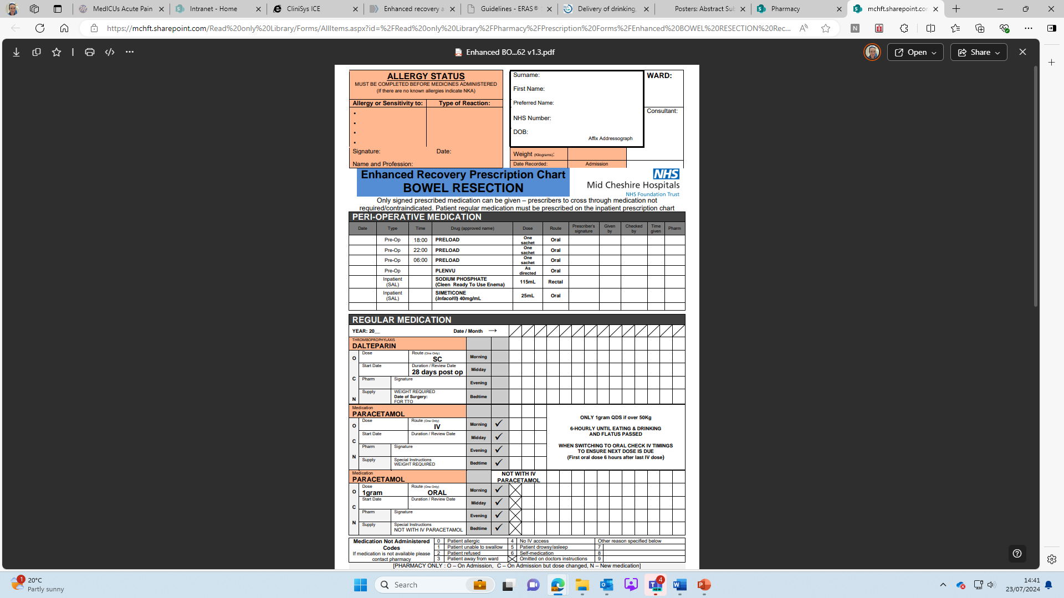
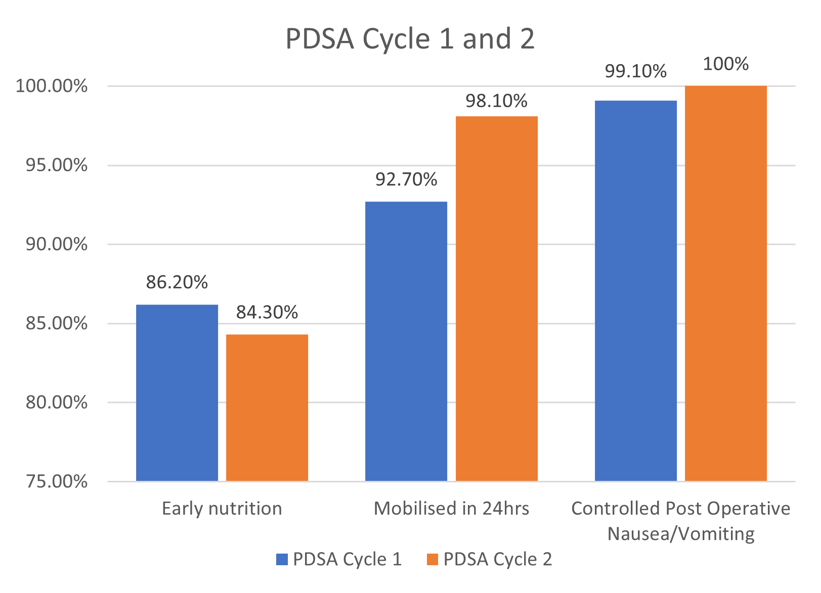
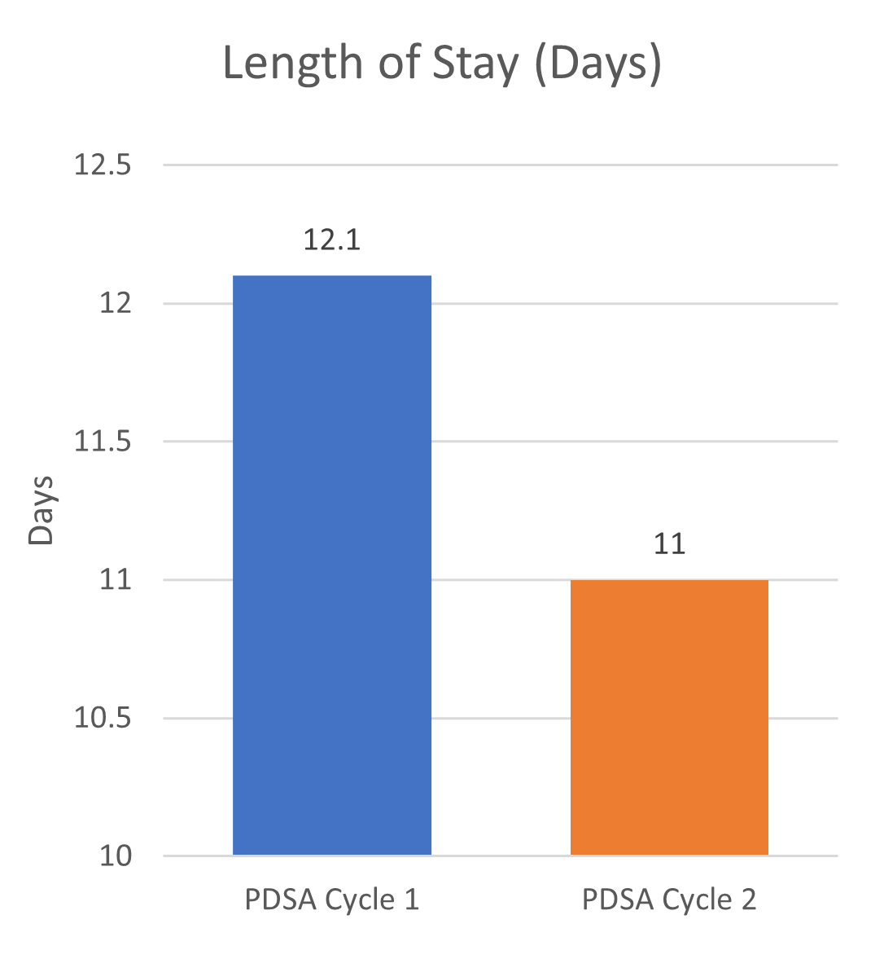
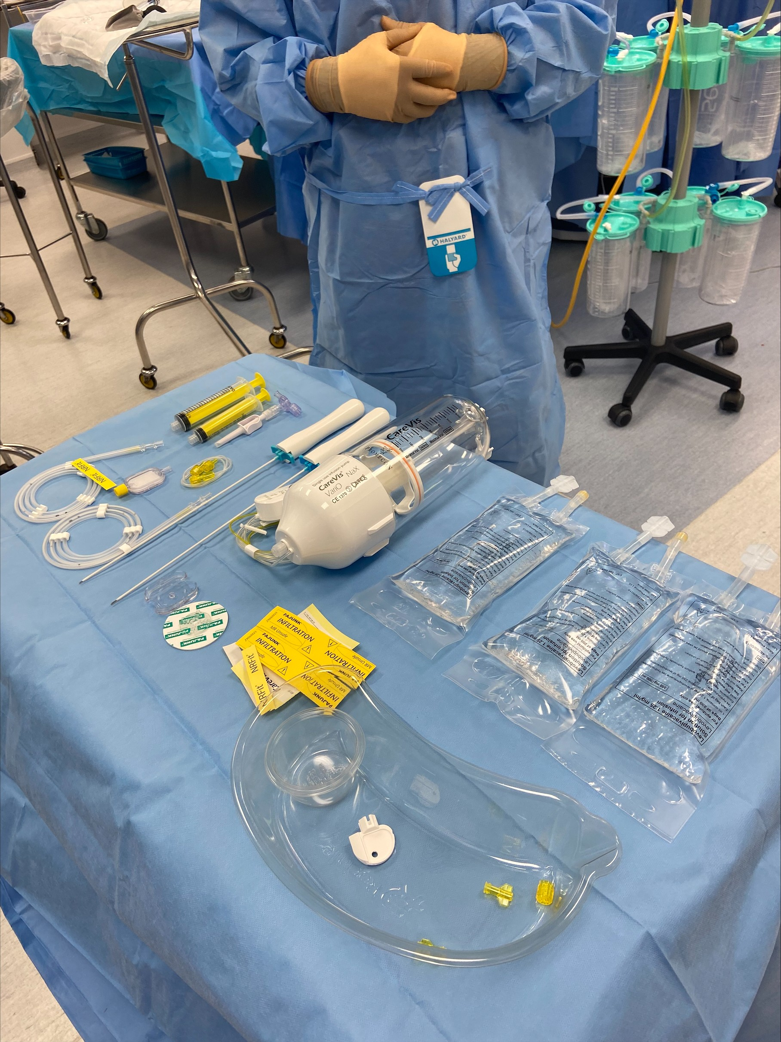
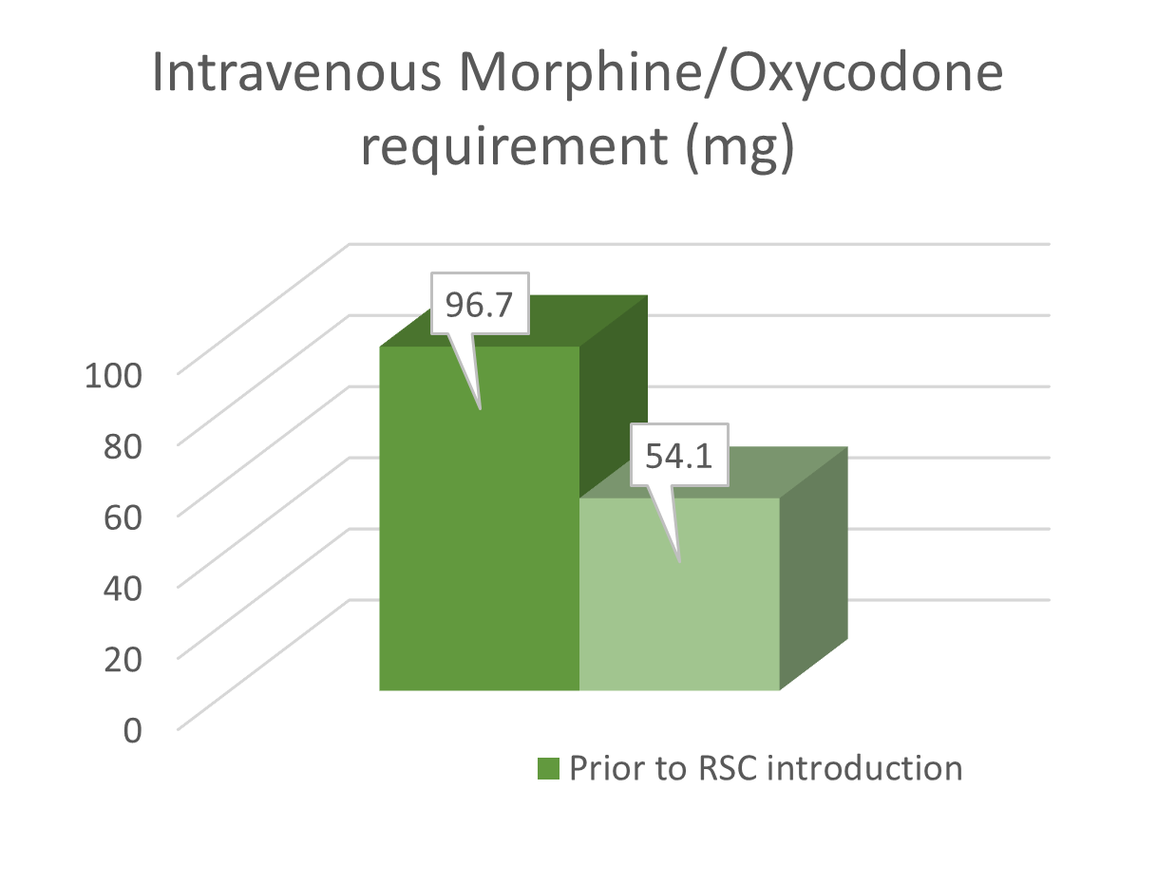
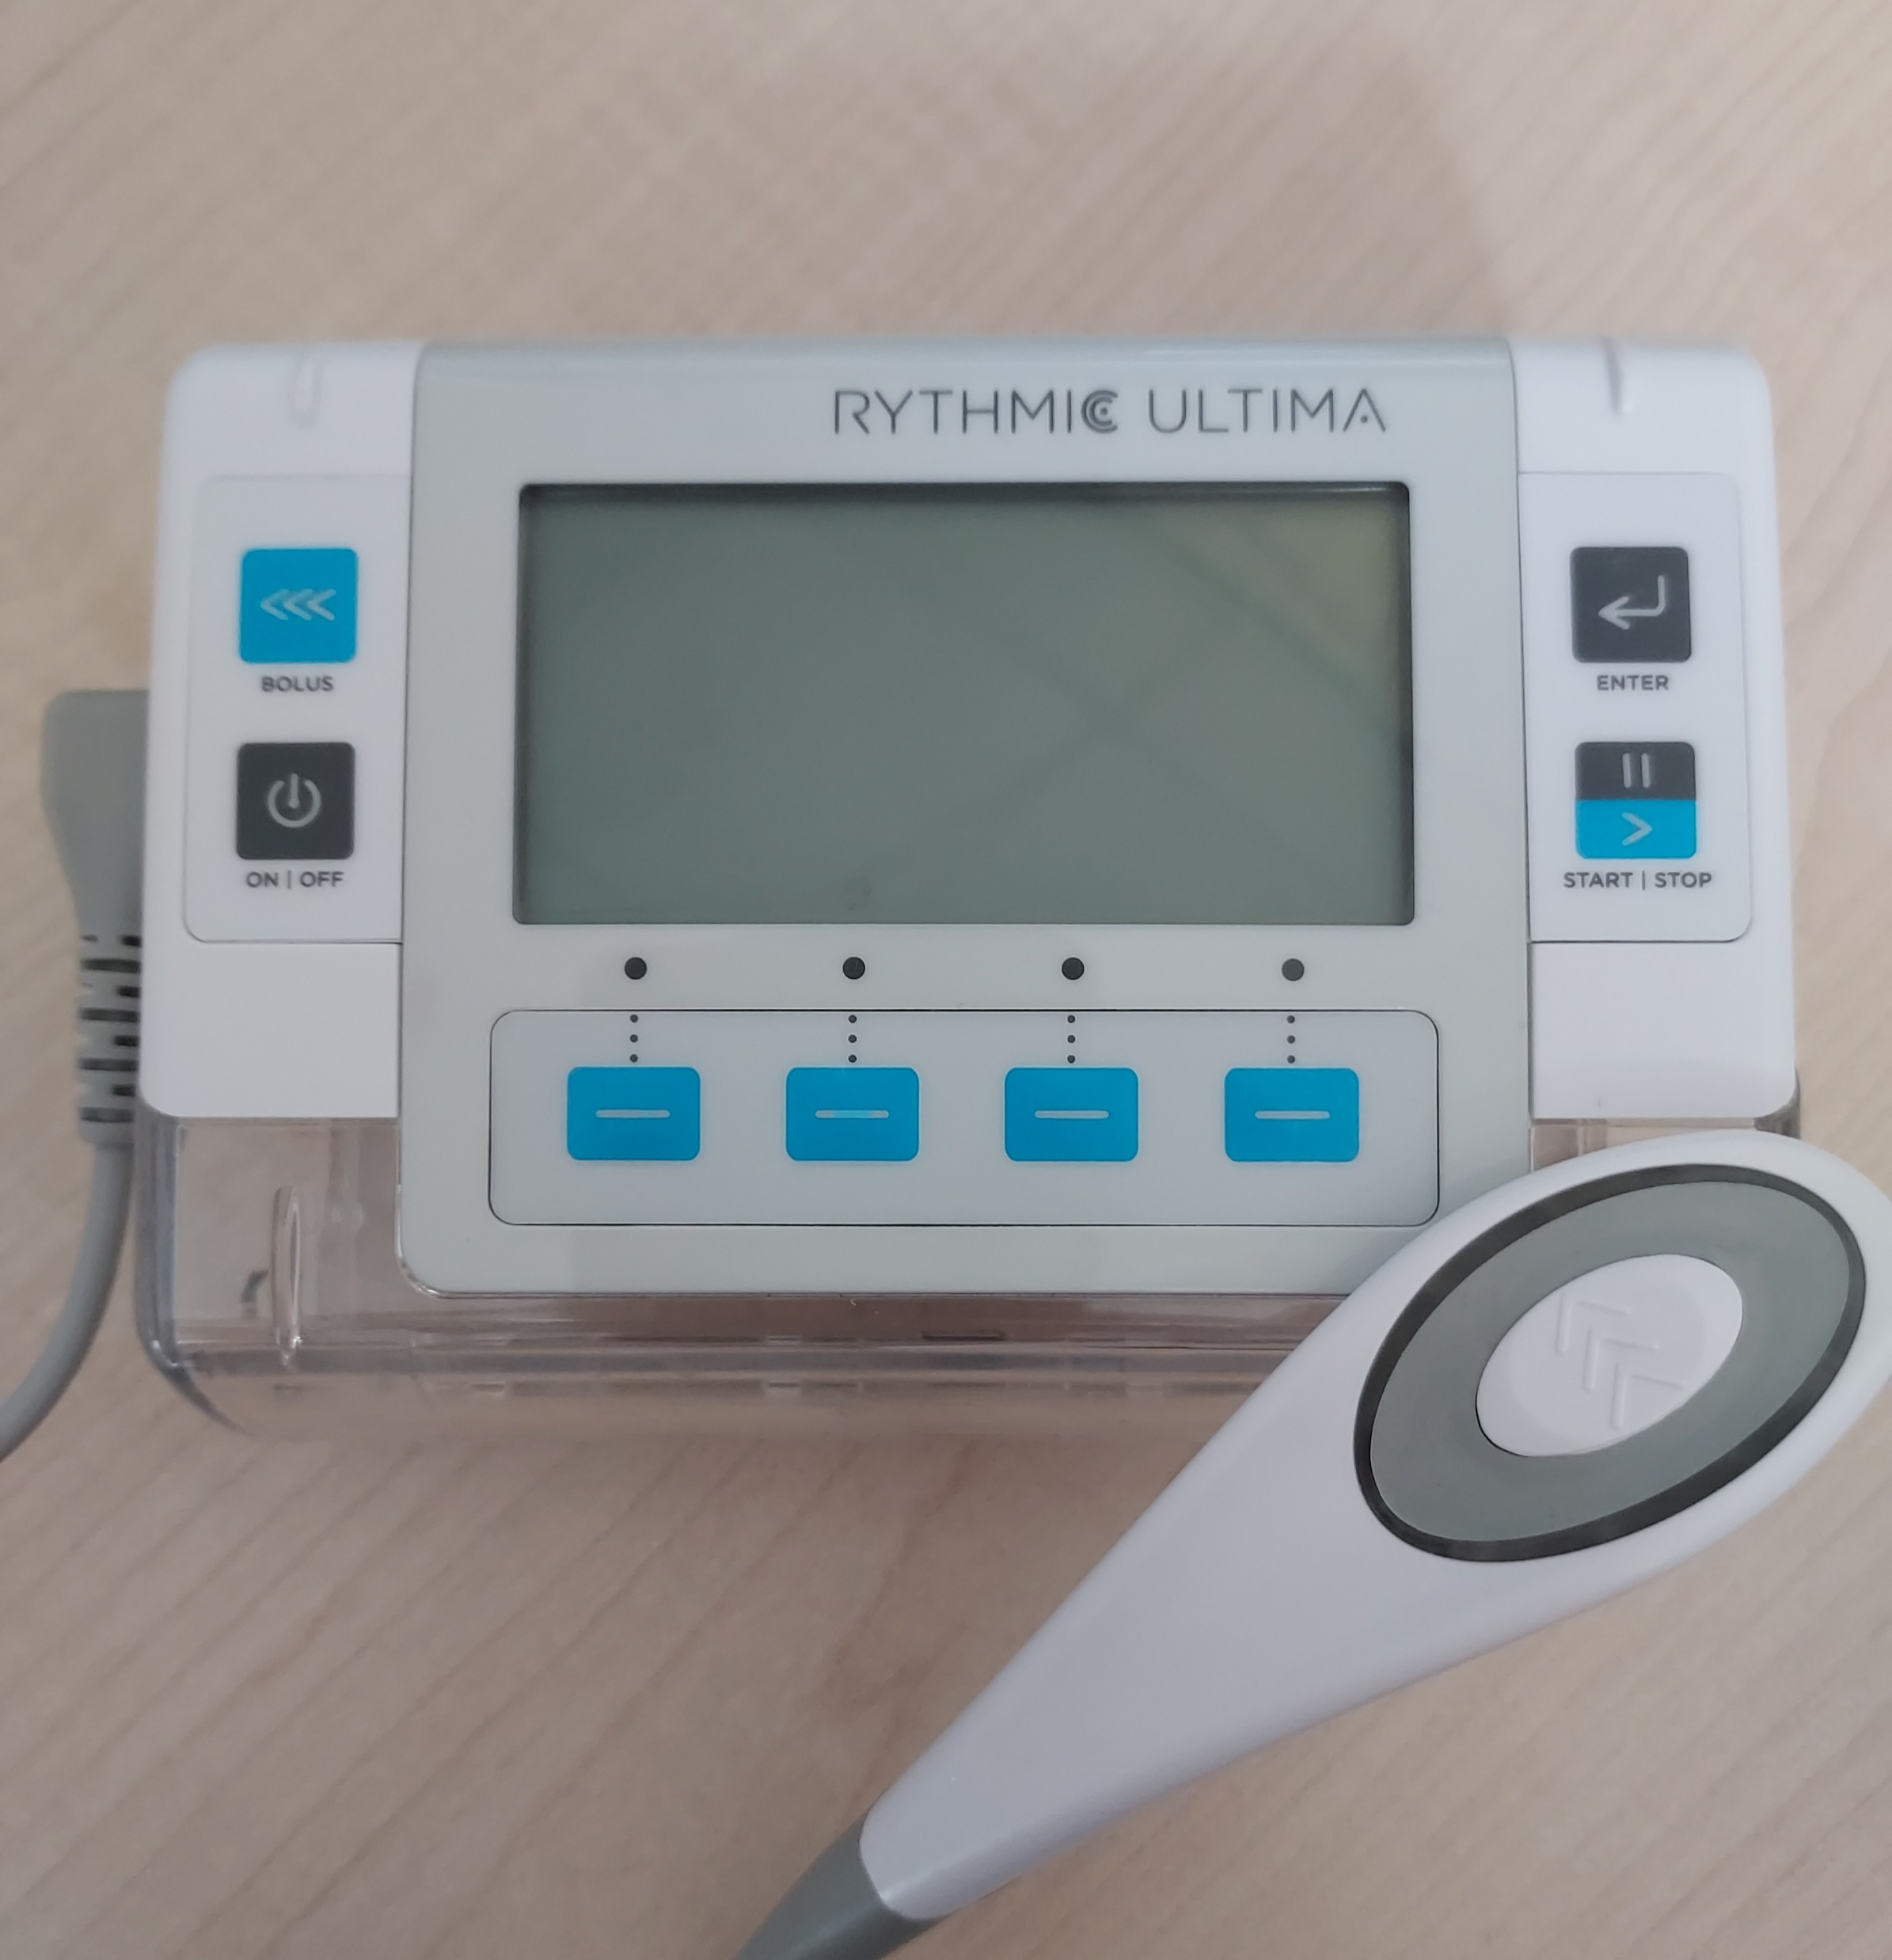
Helping to make DrEaMs a reality; the role of the Acute Pain Service in achieving ERAS goals
Introduction
Methods
Enhanced recovery protocols are associated with improved post operative patient outcomes, the rationale is to reduce the stress response and promote early mobility by consistently delivering standardised processes.
Oliver et al. (2022) proposed a simplified, ‘bundle’, approach to ERAS for major non cardiac surgery, aiming to reduce variability and increase compliance. Supporting patients to Drink free fluids, Eat a soft diet and Mobilise with the maximum assistance of one person (DrEaMing) within 24 hours of surgery ending. In their study Oliver et al. (2022) the consistent delivery of DrEaMing was associated with a significantly shorter length of stay (LOS).
This poster explores the role of the Acute Pain Service in helping to deliver DrEaMing protocols in our District General Hospital in Cheshire.
Our Enhanced Recovery After Surgery (ERAS) Steering group, was established in 2018. It is lead by Sara Carson, McMillan Colorectal Enhanced Recovery Nurse. The Acute Pain Service are part of this multiprofessional team which meets regularly. During this time we have implemented several processes to improve outcomes, including DrEaMing aims and compliance with ERAS. Retrospective data was used to look at the impact of three main projects in three PDSA cycles. Our main cycles (First and Second) looked at nutrition, mobilisation, PONV and LOS. A parallel quality improvement project (Interim PDSA) looked at a subgroup of patients who were suitable for rectus sheath catheters. There was significant crossover between the cohorts so we amalgamated the results to give a full picture of the factors contributing to the final PDSA outcomes.
First PDSA Cycle; Introduction of Pre-Printed Prescription Charts Aiming to reduce delays administering analgesia/PCA stepdown and other essential and standardised prescriptions. Plan: Design and agree prescription chart for colorectal surgical patients with key stakeholders; pharmacy, dieticians and surgeons, audit outcomes. Do: Approval from Surgical, Anaesthetic and Pharmacy governance groups, educate prescribers and nurses on change in practice. Study: 109 patients LOS and outcomes audited. Significant proportion of patients achieving early nutrition, mobilisation and controlled Post-operative nausea and vomiting (PONV). Length of stay 12.1 days. Act: Impact reviewed, agreed to continue with the change in practice.
Results
Interim PDSA Cycle; Introduction of Rectus Sheath Catheters to lessen Opioid Burden
Aiming to reduce nausea and reduce ileus risk.
Plan: Introduce RSC as an analgesic option to open elective and emergency surgical patients
Do: RSC introduced to practice in October 2022
Study: 36 Patients received RSC to date with outcomes audited. Post-operative Ileus occurred in one patient (2.8%), opioid use was reduced, with 8.3% of patients not requiring PCAs. PONV was well controlled (97.2%).
Act: Impact reviewed, agreed to continue with the change in practice, continue to educate and support staff with RSC devices. Consider extending scope of local anaesthesia catheter use to other surgeries.
PDSA Cycles 1 and 2: Comparison of Early Nutrition, Mobilisation, Control of Post-operative Nausea and Vomiting and Length of Stay.
Post-operative Ileus (%) | Controlled Post-op Nausea/ Vomiting (%) | PCA not required (%)
2.8 | 97.2 | 8.3
Second PDSA Cycle; Procurement of new PCA Machines to facilitate early mobilisation
Plan: Alaris PCA Machines no longer supported for use, replaced by lighter, smaller PCA Machines to facilitate early mobilisation.
Do: Trial appropriate PCA devices, Micrel Ultima XS pumps selected, staff training, changes to policy and guidelines for use and prescription and monitoring charts.
Study: Audit outcomes of impact on early mobilising, collect qualitative feedback from nurses, physiotherapist teams and clinicians using devices. Mobilisation increased to 98.1%, control of PONV increased to 100%, length of stay reduced by 1.1 days
Act: Continue to use Micrel devices, ongoing education and support from staff.
Interim PDSA Cycle: Comparison of total IV Opioid requirements, rate of post-operative Ileus, control of post-operative nausea and vomiting, and percentage of patients not requiring PCA
References
Oliver et al. (2022) Delivery of drinking, eating and mobilising (DrEaMing) and its association with length of hospital stay after major noncardiac surgery: observational cohort study BMJ 129(1) 114-126
Surgery and Opioids: Best Practice Guidelines 2021. Faculty of Pain Medicine, of the Royal College of Anaesthetists. 2021 https://fpm.ac.uk/sites/fpm/files/documents/2021-03/surgery-and-opioids-2021_2.pdf (accessed Aug 2022).
Acknowledgements
The biggest thanks goes to Sarah Carson, Colorectal ERAS lead nurse at MCHT, these projects, have been supported and driven by Sarah. Involving huge amounts of time, effort, education, training and guidance to the nursing team to make the projects a success, as well as bringing the MDT together to focus on ERAS goals.
C
Conclusion
These PDSA cycles show our contribution to the MDT and that we have made DrEaMing a reality. Our methods have proven that our patients are able to DrEaM post-surgery, with improved mobilisation, reduced PONV and reduced length of stay. In main PDSA cycles, of the four outcome measures there has been improvement in three. We have also seen a significant reduction in opioid use in patients with Rectus Sheath Catheters.
The next PDSA cycle aims to look at barriers to early nutrition and how to address this.
As the Acute Pain Service at a District General Hospital, we have implemented three different improvement measures, allowing our patients to DrEaM!
Anneka Field: Clinical Lead for Mid Cheshire Hospital Acute Pain Service anneka.field@mcht.nhs.uk
Angela Deeley: Consultant Lead for Mid Cheshire Hospital Acute Pain Service angela.deeley@mcht.nhs.uk

Slide 9
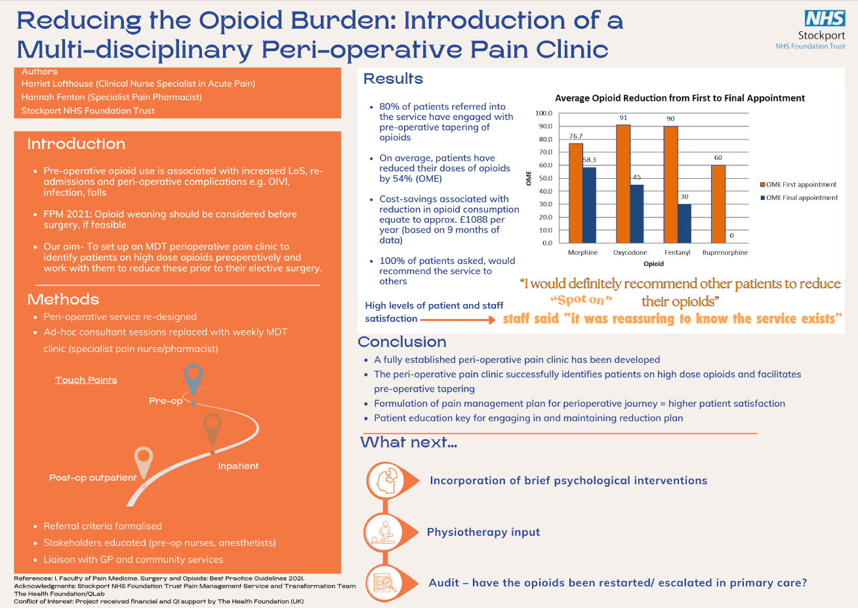

Slide 11

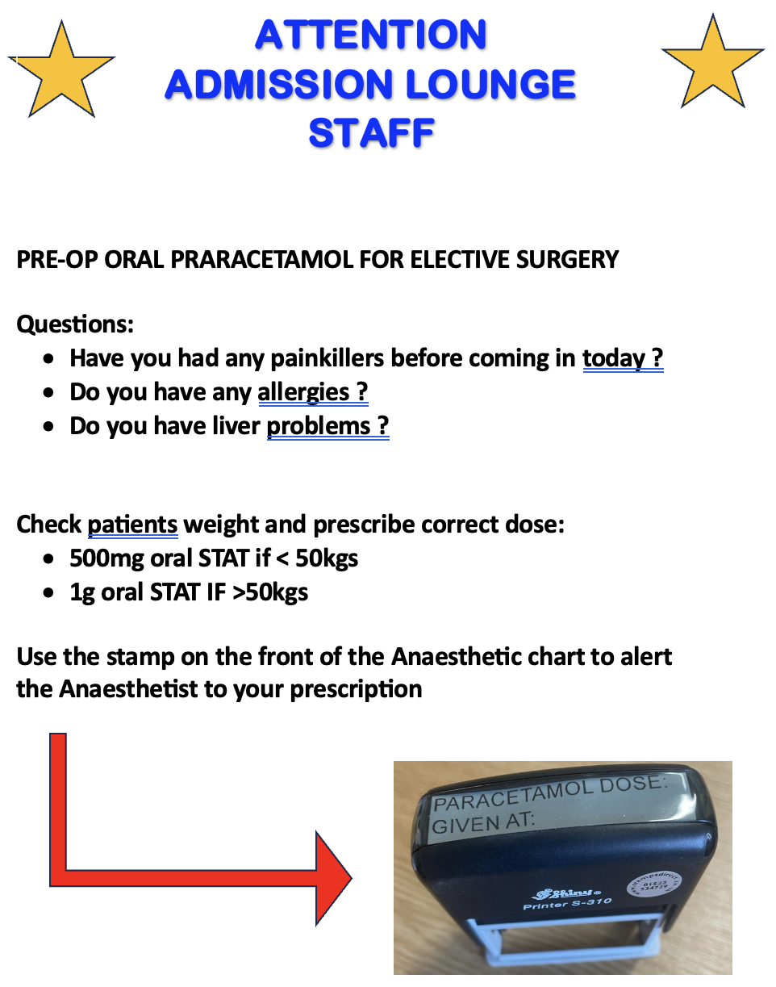
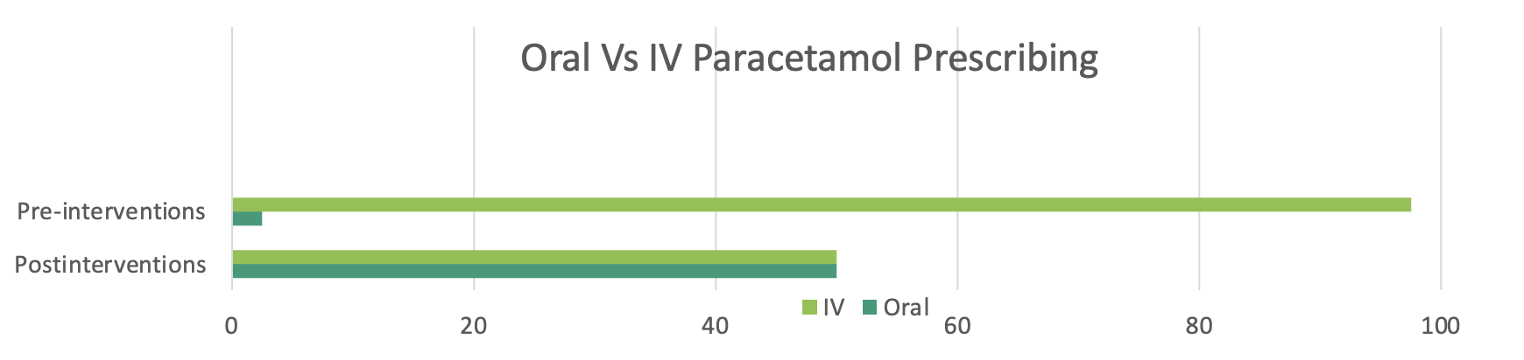
Author
Dr Lucy Brown (CT1 Anaesthetics)
Supervisor
Dr Corrine Rimmer (Consultant Anaesthetist)
Standardising Oral Paracetamol Administration for Elective Surgery Patients
Method
Several interventions were used to improve the rate of oral paracetamol prescribing and administration:
Nursing staff proforma for prescribing guidance (Fig 1)
Reminder posters for Anaesthetic colleagues
Reminder presentation at Audit meeting
Stamps providing dose and time of oral paracetamol administration for use on paper anaesthetic charts
The plan was for nursing staff in admissions lounge to prescribe and administer oral paracetamol using the proforma for guidance. This would provide a record of the administration on the E-prescribing system. Following this they would use the stamps on the anaesthetic chart to alert the theatre team to the prescription providing a safety net and preventing duplicate prescribing errors.
Results
Data was collected from a random sample size of 40 patients before and after the intervention. A drastic improvement was found in oral paracetamol usage following the interventions. In the sample size 50% of patients received oral paracetamol compared to 2.5% prior to intervention (Fig 2). The trust saved £24.22 for this sample size alone. Following this pilot we have sucessfully rolled out this project across other hospitals in the trust.
Conclusion
There was a vast improvement in oral paracetamol prescribing following the intervention. However, several barriers to change were identified. These included: staffing changes, system/ logistical difficulties, difficulty breaking habits and inadequate clear explanations to patients.
Moving forward, on expansion of the initiative to additional sites, we aim to break down these barriers by providing a patient information leaflet, recruiting more staff to be involved in the project and continuing to remind teams of the many benefits of switching IV medicines for oral alternatives.
Aim
For all eligible elective surgery patients to receive a dose of oral paracetamol in the pre- operative lounge prior to their surgery.
Background
There are numerous benefits of giving patients oral medications over IV including:
Reduced carbon footprint
Reduced cost [1]
Improved patient experience
Reduced risk of IV infections [2]
Oral and IV paracetamol have similar oral bioavailability [3]. When pain scores are assessed post-operatively, very little difference is seen between the two routes of administration [4]. At Royal Lancaster Infirmary (RLI) paracetamol is given to the majority of elective surgery patients via the IV route intra-operatively. Anecdotally this was found to be due to several reasons: habit, awareness of nursing staff pressures and concerns around prescribing errors.
(%) cases prescribed
Fig 2. Graph demonstrating the increase in the number of patients given oral paracetamol after the interventions when compared with IV paracetamol. Taken from a random sample size of 40 elective surgery patients.
References
[1] Min Na Eii et al. BMJ, 2023,383:e075297
[2] Jissa Maria Cyriac et al. JPP. 2014 Apr-Jun; 5(2): 83–87
[3] Liza Tharakan et al. BJA Education, 2015, 15 (4):180-183
[4] M Mallama et al. Anaesthesia. 2021 Feb;76(2):270-276
Fig 1. Proforma for nursing staff to follow for administration of oral paracetamol in pre-operative lounge.

Slide 12
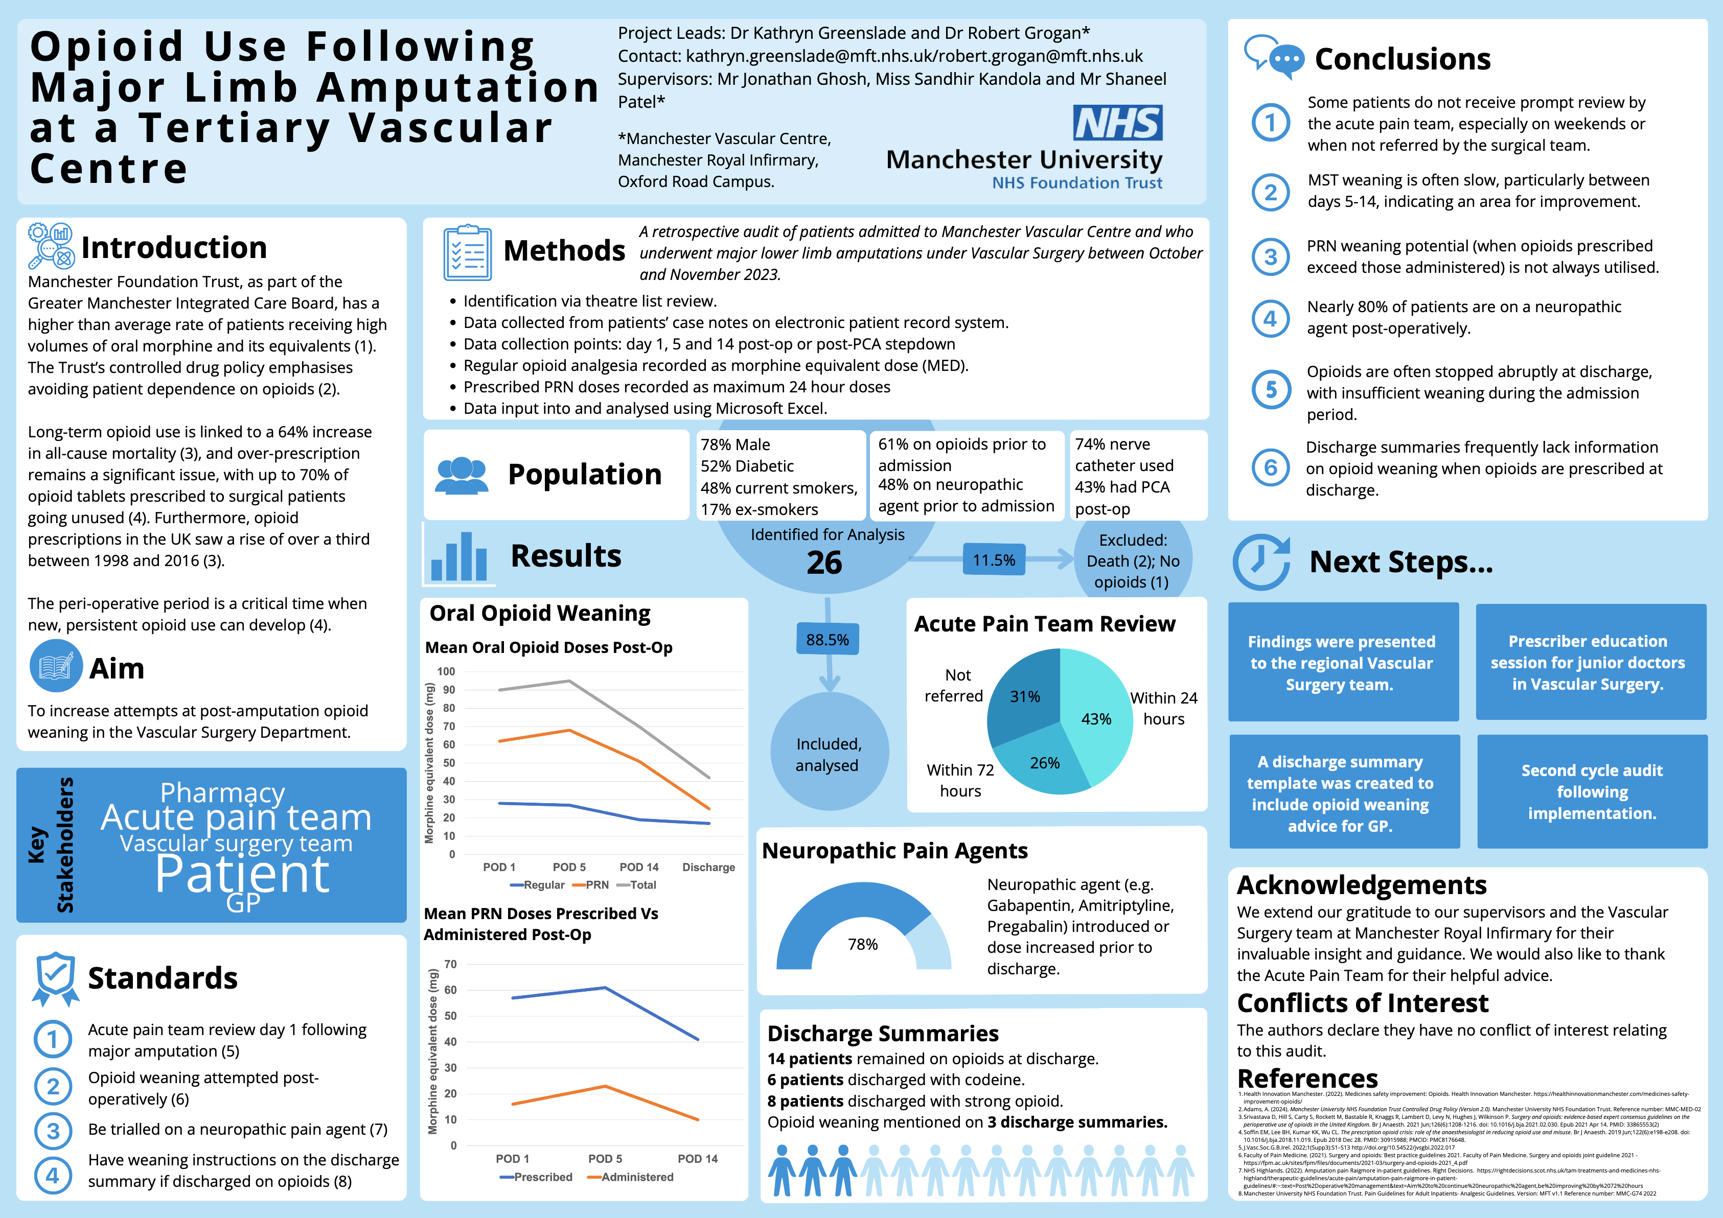

Slide 13
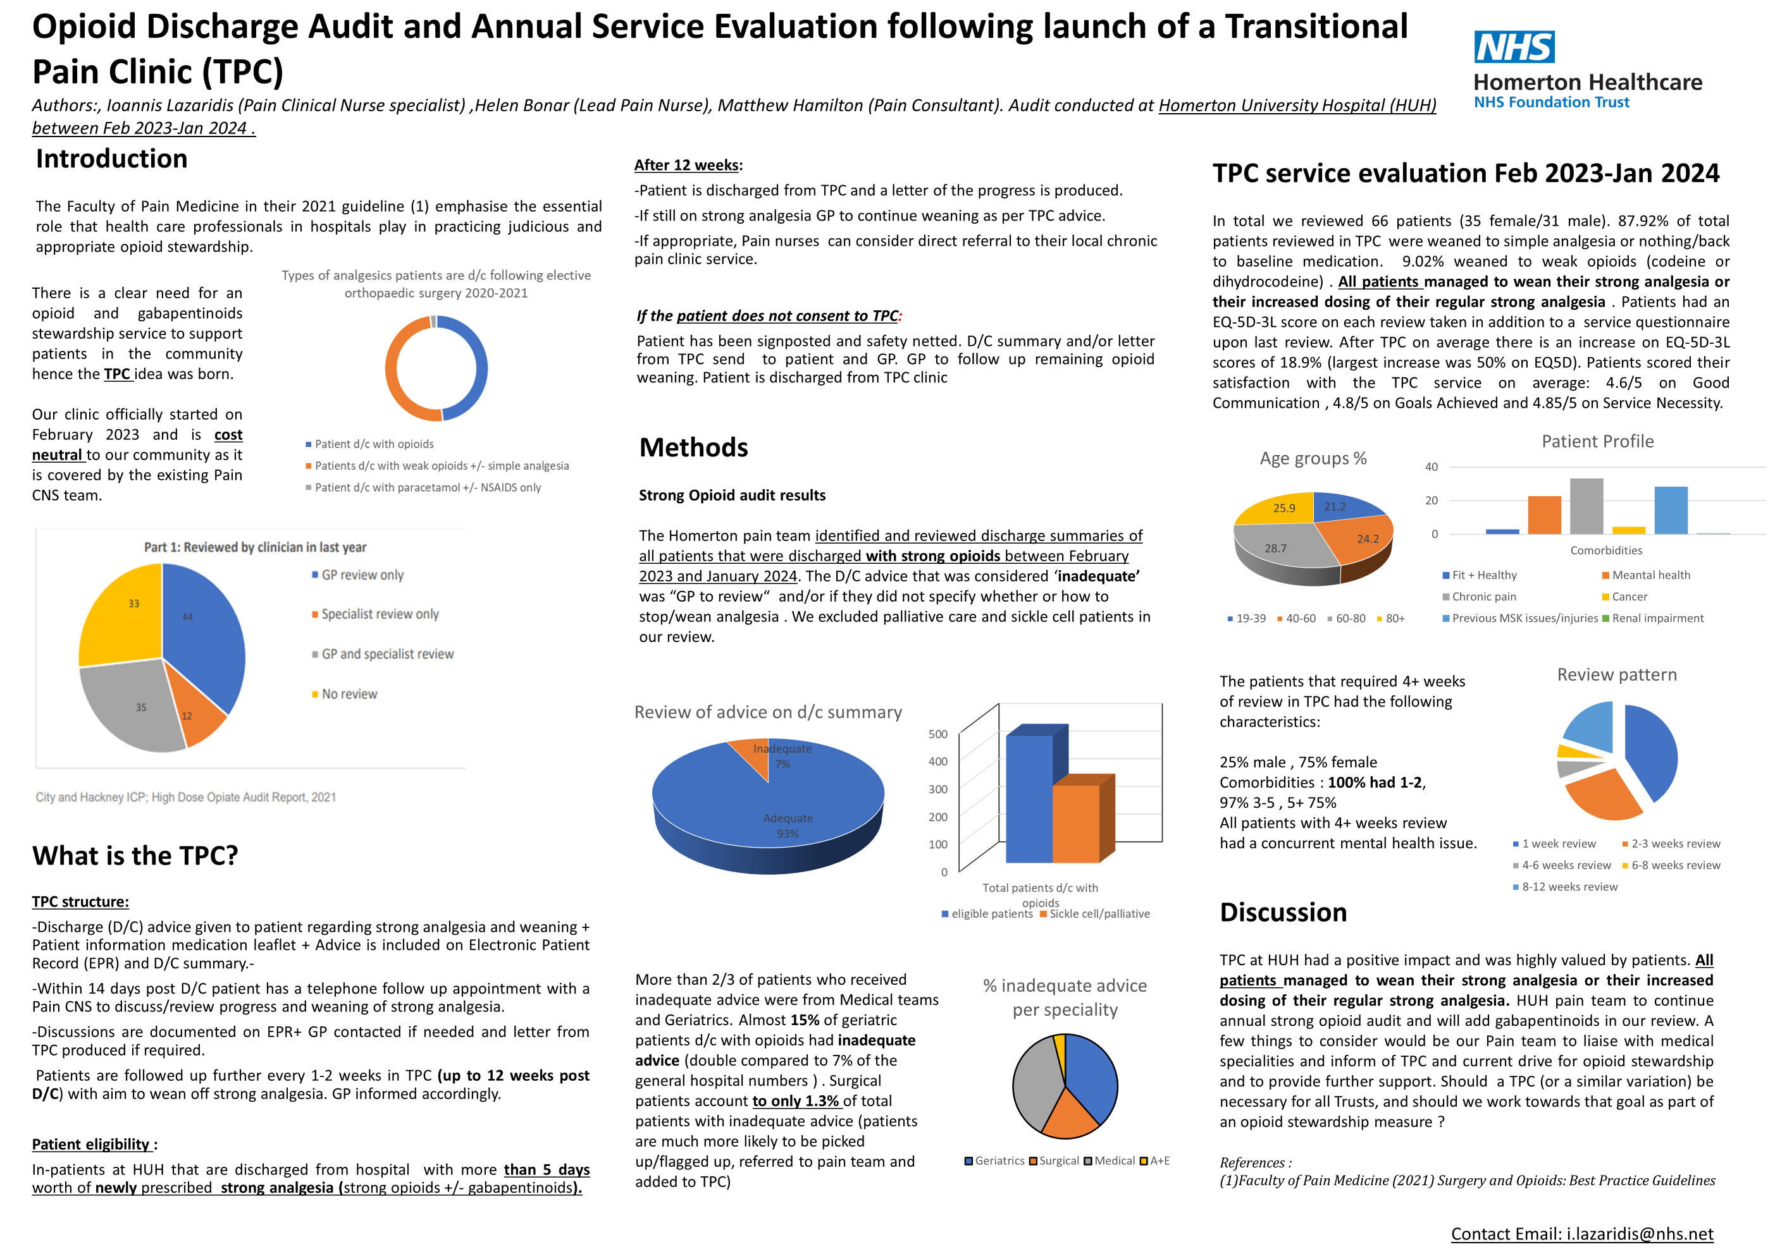

Slide 14



Transition from epidural to oral analgesia
Authors: K Grabham^{1,4}, R Kinnear-Mellor^{2,4}, B Morgan^{3,4}
¹Acute Pain Nurse, ²Consultant Anaesthetist, ³ST7 Anaesthetic Registrar, ⁴Nottingham University Hospitals
Introduction
Epidural analgesia is considered to be the gold standard of analgesia in many settings, usually continued for several days until transitioning to alternative analgesia.
There is a lack of an evidence base globally to support a specific analgesia transition plan, and we have not previously examined the effectiveness of our management of this transition in our Trust.
This audit is to determine how well we manage this transition, aiming for pain scores of mild or less on day 1 post-epidural.
Results and Conclusions
50 patients
56% male
x̄ age 62
58% emergency surgery
Most frequently for rib #s
Also colorectal, HPB and vascular surgery
96% mixed epidural bags
Median duration 5 days
Additional analgesia only prescribed in 21%
D1 pain score post-epidural removal
D1 moderate and severe pain associated with:
Patient sex: 60% female (vs 44% overall)
Epidural mix: 20% plain (vs 4% overall)
Post-epidural analgesia opioid and route:
fentanyl (vs oxycodone/morphine)
PCAs (vs PO/SC)
Methods
Prospective data collection via audit form on patients with epidurals, until sample size of 50 reached.
Data collected on: patient demographics, surgery type, epidural type, epidural duration, additional analgesics, and pain.
Achieved D1 pain scores of mild or less in 79%.
All moderate and severe pain improved on D2 (to mild and moderate respectively).
D1 pain associated with above factors. Scope to alter Trust practice to consistently transition to oral opioids post-epidural removal.
Departmental presentation and re-audit planned.
No conflicts of interest / funding to declare

Slide 15
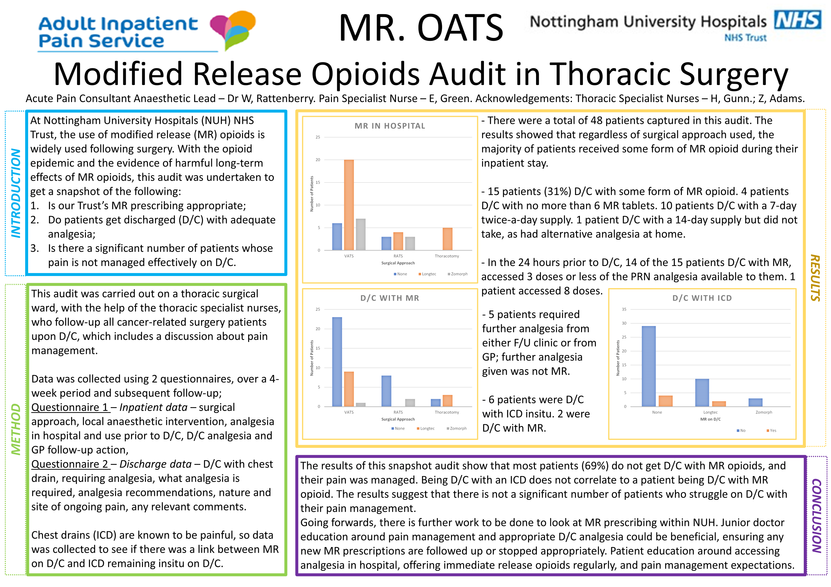

Slide 16
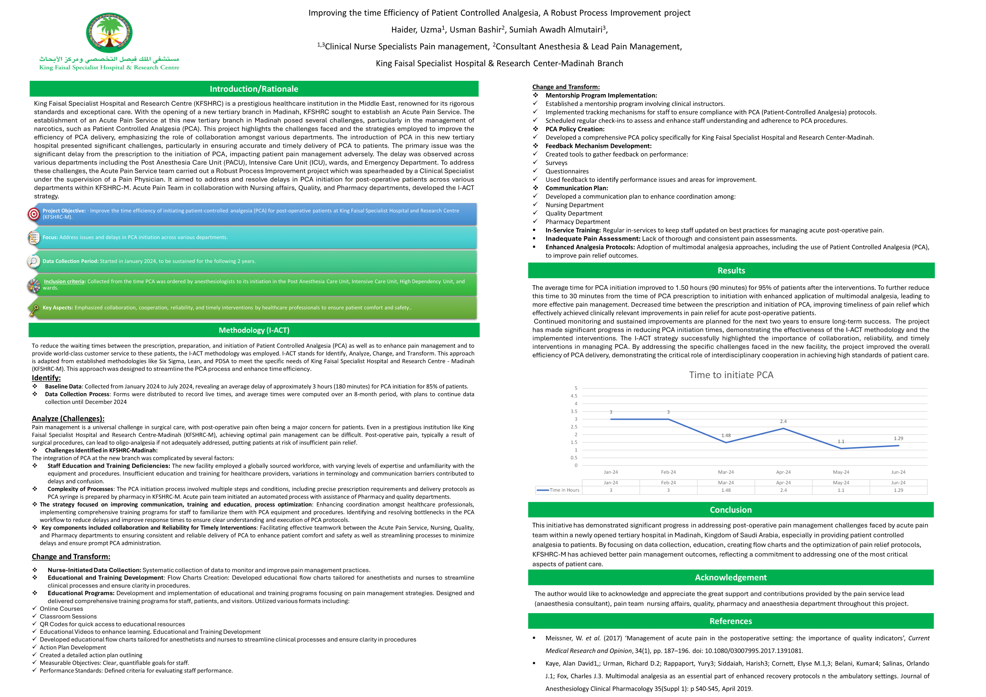

Slide 17
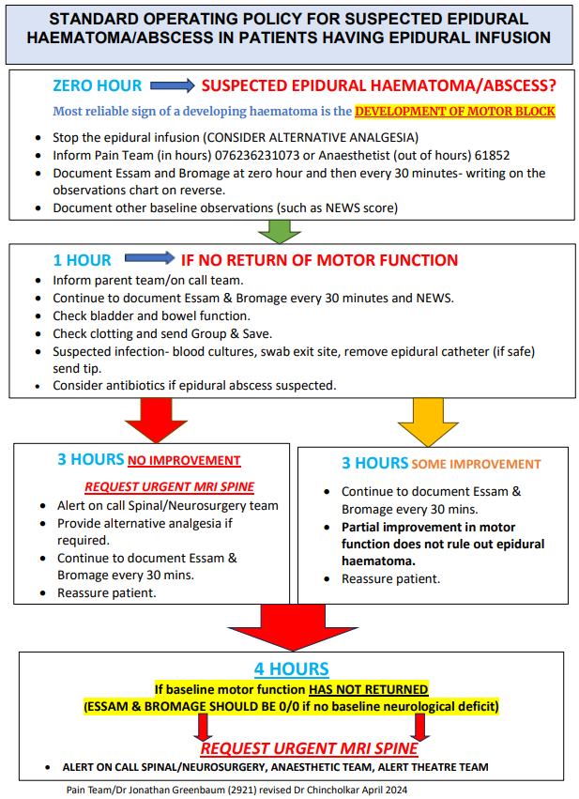
To scan or not to scan?
The importance of learning from patient safety incident.
N Baldwin, R Taylor, B Poulton, F Murison, K Savage, M Howarth, N Symes-Thompson, L Melling, J Shields, R Wilding Manchester & Salford Pain Centre,
Salford Care Organisation, Northern Care Alliance
Patient A (63) attended for a laparotomy for a benign cystectomy and formation of ileal conduit due to incontinence and pelvic pain. She had a thoracic epidural placed at T8-T9 pre-operatively. After discharge to the high-care ward she initially developed weakness below the knees which started improving but then developed arm weakness despite her epidural infusion being stopped. An MRI scan was organised as her ESSAM and Bromage score did not resolve which showed spinal cord compression. It was unclear on the MR scan if this was due to blood compressing the cord. The decision to operate was made by the neurosurgical team who found prominent arachnoid posterior to the cord which was ventrally displaced in keeping with a cyst, and clear fluid present. Post thoracic decompression her neurology continued to improve and returned fully within the week, and she was discharged home with full limb power.
Timeline of events
26.03.24 - 11.30 | Thoracic epidural inserted
17.25 | Admission to recovery – neurology appropriate
20.00 | Admission to ward – neurological symptoms to hands and legs
20.20 | Contacted doctor and epidural stopped
22.20 | Patient reviewed, leg movement improving but has developed arm weakness. PCA commenced.
27.03.24 02.00 | Patient re-reviewed, neurology improved somewhat but fluctuating. Due to improvement no MR scan organised
07.40 | Re-assessed – improved grip strength but still weakness in legs
09.00 | Pain nurse review – consultant anaesthetist contacted and reviewed - MRI ordered
 | MRI delayed due to emergencies
14.20 | MRI done – spinal cord compression
19.20 | Operation by neurosurgical team. No blood found but clear fluid present.
02.04.24 | Neurology continued to improve post-operatively and returned fully
09.04.24 | Patient discharged
Learning from events
ESSAM and Bromage monitored as standard
Ward staff informed anaesthetic registrar appropriately
Epidural stopped appropriately as per epidural policy
MRI scan should have been organised when neurology did not return to baseline after 4 hours
Complicated by fluctuating neurology which delayed decision to proceed with MRI scan
Patient likely had subdural local anaesthetic spread which is a recognised complication and an arachnoid band that caused the accumulation of local anaesthetic contributing to the confusing neurological picture. This confused the clinical picture and influenced the decision making.
Policy changes
If at 3 hours there is some improvement clinicians should continue to observe and at 4 hours if the neurology has not returned to baseline, an urgent scan should be organised

Slide 18
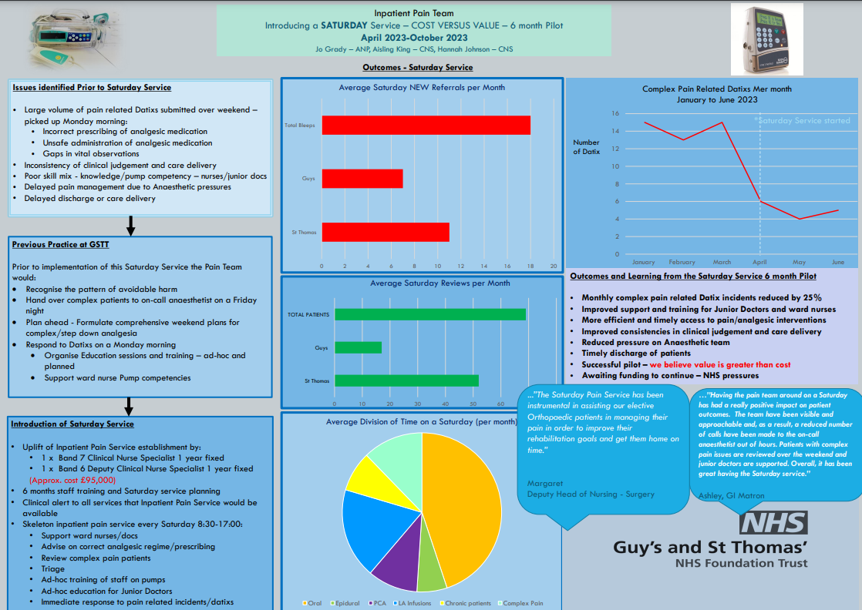

Slide 19
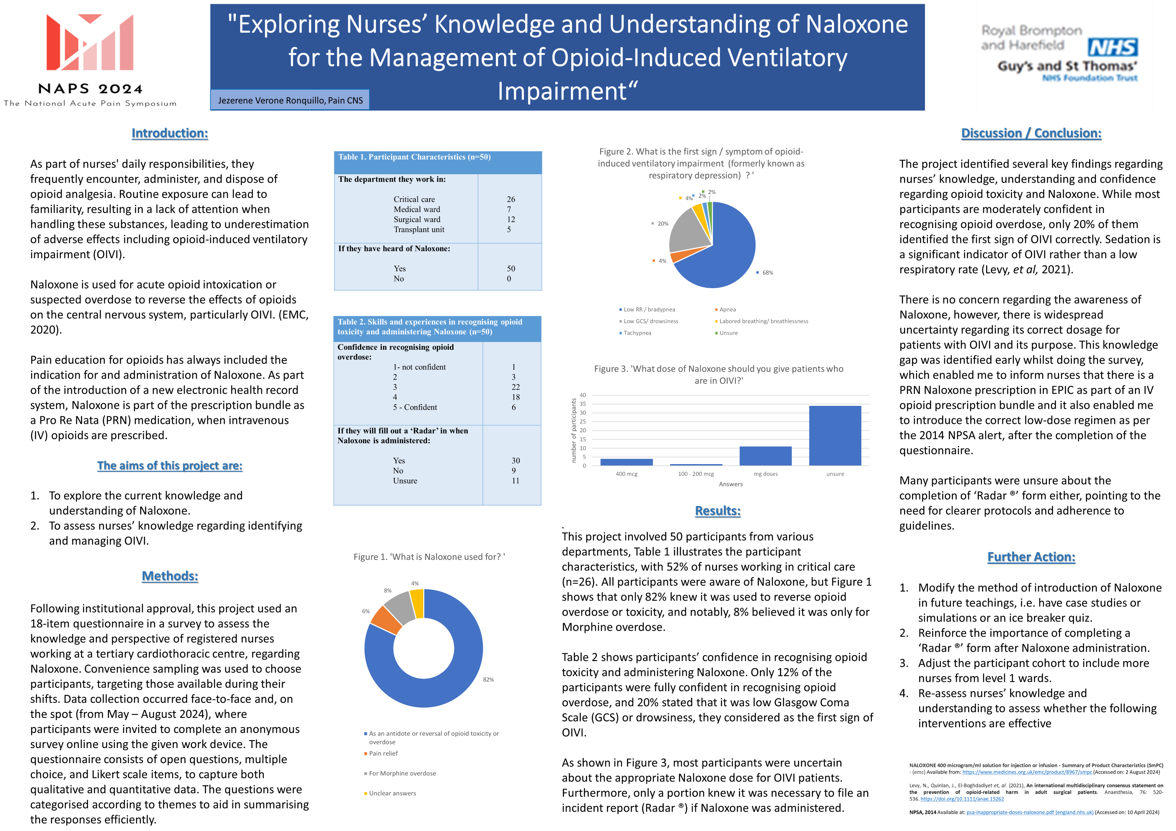

Slide 20

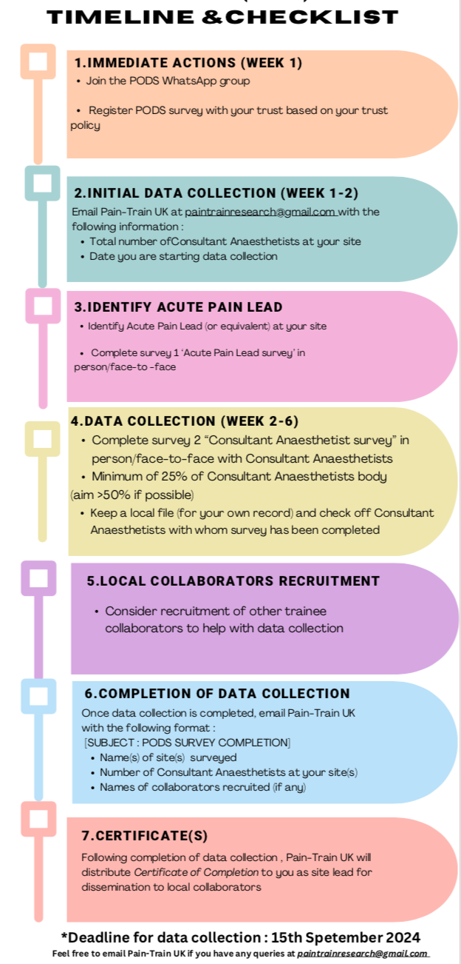
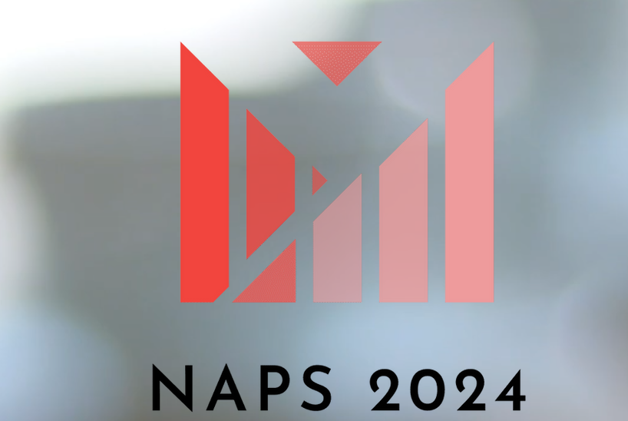
PODS: Peri-operative Diamorphine Shortage
Ka Po Tam ¹, Vitul Manhas ¹, Ailbhe Brady ², Shiva Tripathi ³
University Hospitals of Leicester NHS Trust and Pain-Train UK
Mersey and West Lancashire Teaching Hospitals NHS Trust and Pain-Train UK
Lancashire Teaching Hospitals NHS Foundation Trust and Pain-Train UK
METHODS
Evidence suggests that the use of intrathecal hydrophilic opioids reduces postoperative pain scores within the first 24 hours and reduce intravenous opioid consumption (1). However, there is a lack of guidance regarding the choice and dosage of opioids used for non-obstetrics patients.
Since 2019, there has been an ongoing diamorphine shortage in the United Kingdom (UK). With diamorphine being widely used in obstetrics practice, the Obstetrics Anaesthesia Association (OAA) issued a commentary based on the NICE guideline for caesarean section in 2021. The recommendations include the use of alternative opioids for intrathecal use and hourly patient monitoring for respiratory depression when morphine is given intrathecally in the first 24 hours.
Despite diamorphine being the opioid of choice in many non-obstetrics cases, there is an absence of similar recommendations to guide the enforced change in practice due to the shortage of diamorphine availability. This is an area where practice is likely to vary depending on the organisational structures of different hospitals and surgical services.
The AIM of this project is:
To understand the impact of diamorphine shortage on UK anaesthesia practice in non-obstetrics patients for postoperative pain management and describe the potential changes in individual clinical practice across UK consultant anaesthetists.
This project is undertaken by Pain-Train UK and is supported by the Faculty of Pain Medicine of the Royal College of Anaesthetists.
This is a national audit looking at the extent to which analgesia and mode of anaesthesia has change since the onset of the diamorphine shortage in non-obstetric patients.
Local coordinators are recruited to complete data collection at individual sites.
-Data collection includes an organisational survey to be completed by the trust’s acute pain lead and a consultant anaesthetists survey to be completed by local consultant anaesthetists, aiming at a response rate of 25% per trust.
Local coordinators are advised to register this project with their local audit departments.
INTRODUCTION
Data collection is ongoing, and we aim to survey at least 100 hospital sites across the UK.
Both surveys will be reported using descriptive statistical analysis.
RESULTS
CONCLUSIONS
We will describe the organisational response to the national diamorphine shortage in the management of non-obstetric peri-operative pain and analyse the changes in individual anaesthetist’s clinical practice related to the diamorphine shortage.
REFERENCES
1. Koning, M.V. et al. (2020) ‘Intrathecal hydrophilic opioids for abdominal surgery: A meta-analysis, meta-regression, and trial sequential analysis’, British Journal of Anaesthesia, 125(3), pp. 358–372. doi:10.1016/j.bja.2020.05.061.
Pain-Train UK Committee
ACKNOWLEDGEMENTS

