Slide 1

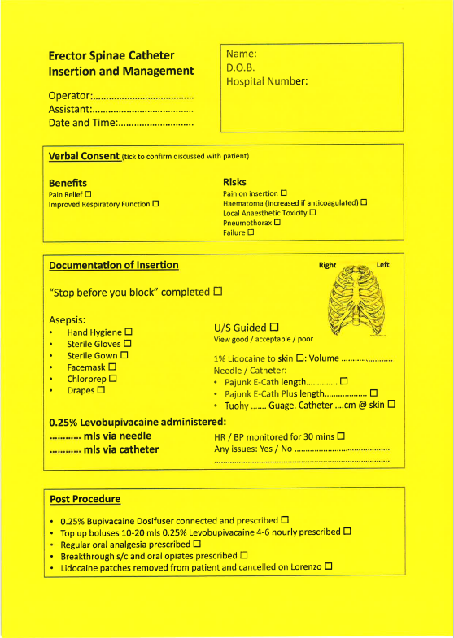
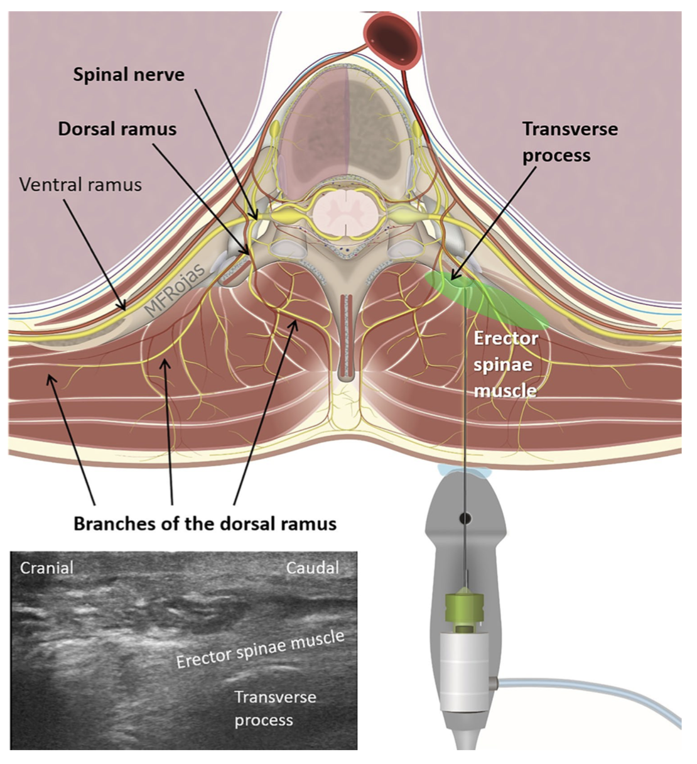
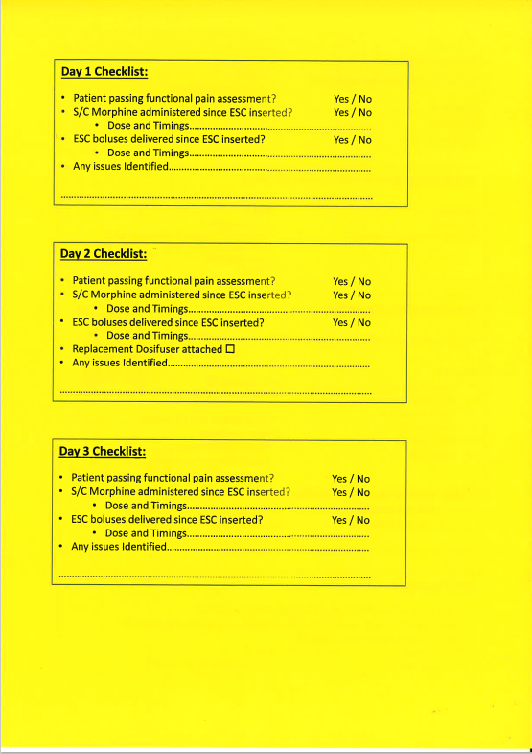
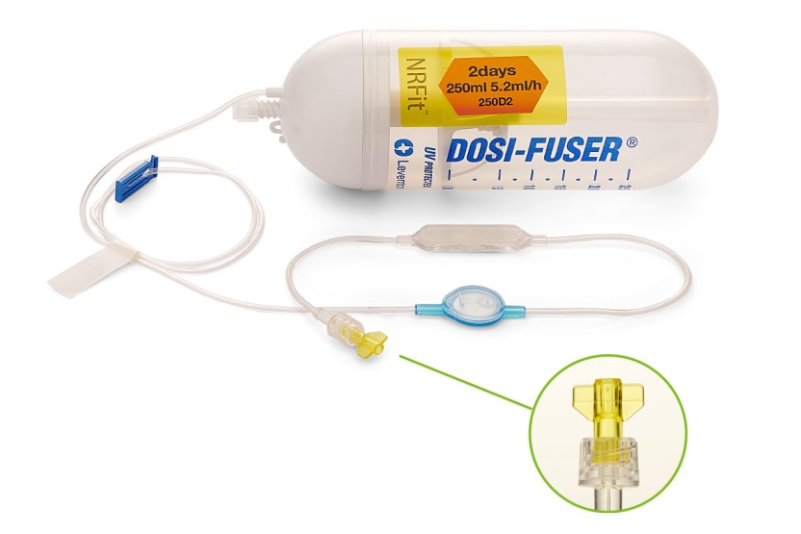
Improving access to ESB analgesia in rib fractures
What is an ESB?
It is a paraspinal fascial plane block, with the use of a ultrasound guided needle placement between the erector spinae muscle and the thoracic transverse processes, and a local anaesthetic is administered, blocking the dorsal and ventral rami of the thoracic and abdominal spinal nerves.
Blocking the dorsal and ventral rami of the spinal nerves helps to achieve a multi-dermatomal sensory block of the anterior, posterior, and lateral thoracic and abdominal walls. The aim is to enable the patient to deep breath and cough reducing the risk of respiratory complications after sustaining fractured ribs.
Previous practice at Royal Derby Hospital
Prior to implementation of this project, patients identified as needing an ESB catheter would be admitted to our Surgical Step Down Unit (a level 1+ ward). The ESB catheter would either be inserted while the patient was on SDU or would be booked on the emergency list depending on anaesthetic availability and skill mix.
Issues this project aimed to address
Restricted use of ESBs as bed availability on SDU is limited.
Delays in administration of effective analgesia as patients needed to wait for a bed to be available, or for a theatre slot on the emergency list.
Pressure on critical care capacity: our SDU ward is primarily intended as a post op destination for more complex surgical patients not requiring organ support on ICU/HDU. Utilising these beds for rib fracture patients increases the pressure on beds and the risk of on-the-day cancellation of elective surgery due to lack of bed availability.
Evidence discussed at NAPS 2022 suggested that the alternative local anaesthetic option (lidocaine patches) were only minimally effective. Widening access to regional analgesia for rib fractures has additional benefits such as reducing opioid consumption and side effects.
Aims of the project:
To improve timely access to more effective regional analgesia
Reduce patients' needs for opiate analgesia (and associated side effects)
Reduce demand on critical care resources.
What did we change?
Changed policy so ESB catheters can be managed on normal surgical wards.
NAPS 2022 established this practice in other trusts
Royal Derby Hospital (RDH) experience to date had shown no issues with complications secondary to ESB catheters that needed higher nursing care.
Moved infusion via Elastomeric pumps (dosifser) using 0.25% Bupivacaine at fixed rate of 5.2mls per hour. Surgical ward nursing staff already familiar with these as commonly used for rectus sheath catheters and popliteal catheters following lower limb surgery and amputations.
Education for the Acute Pain Nurse in how to administer supplementary bolus of local anaesthetic in case ‘top ups’ needed.
Deployed a process to allow ESB catheter insertion in ED/SAU or surgical ward.
Block Trolley (lockable) including local anaesthetic toxicity guidelines
Sonosite Ultrasound
Portable monitoring including Mindray ECG
SDU admission no longer necessary for management of ESBs, however rib fracture patients at significant risk of early deterioration to still be considered for SDU.
Results:
42 ESB catheters inserted from Jan to July 2023
Only 8 of those patients required admission to SDU
Average LOS on SDU for rib fractures 6 days, so estimated 204 SDU bed days saved.
SDU bed daily cost is £318 greater than normal surgical ward. Therefore estimated cost saving of £64,872
ESB Catheter Insertion Documentation
Future Plans
Train acute pain nurse specialists in siting catheter
Evolve service so patients can go home with ESB’s with outreach service – model already in place for popliteal catheters and elective orthopaedic surgery
Authors:
Tobias Matthew-Tilley, Chim Mtabilika, Vicki Yates
Stefan Valdinger, Stephen Sarno, Imogen Sisley

Slide 2
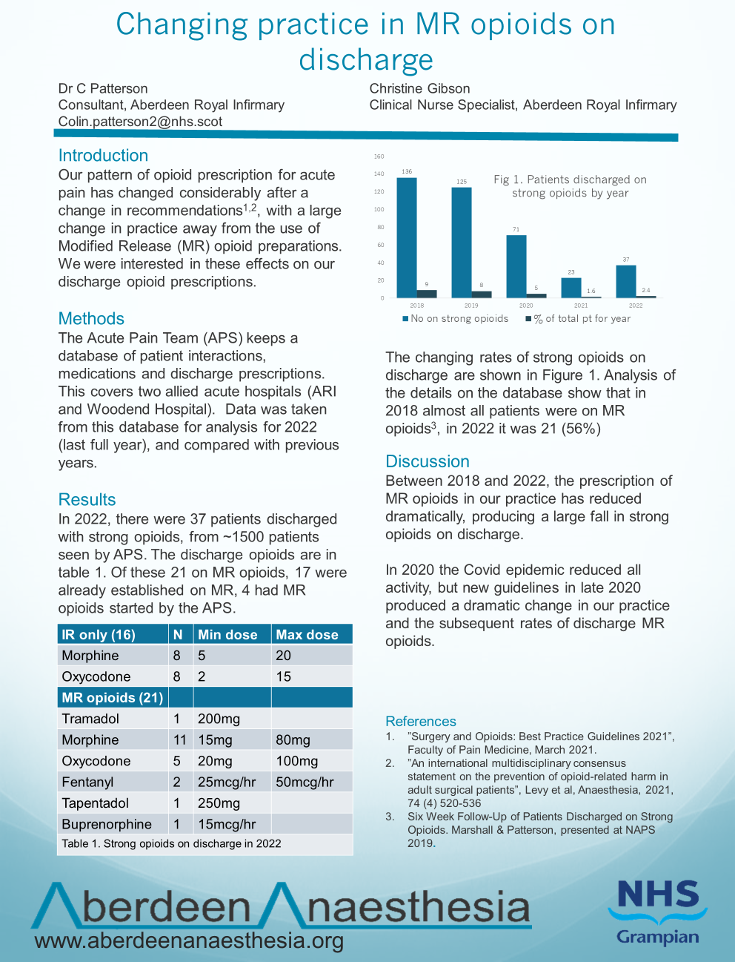

Slide 3
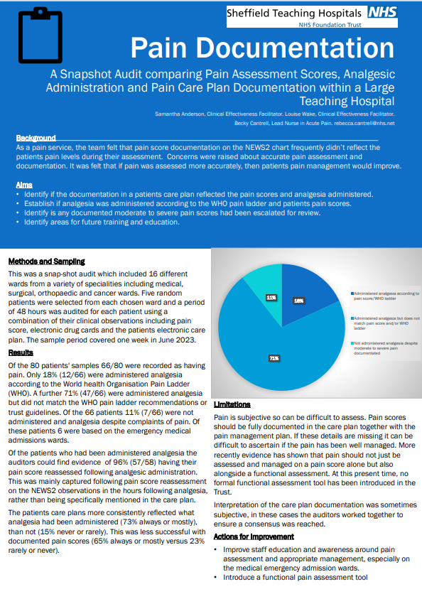

Slide 4
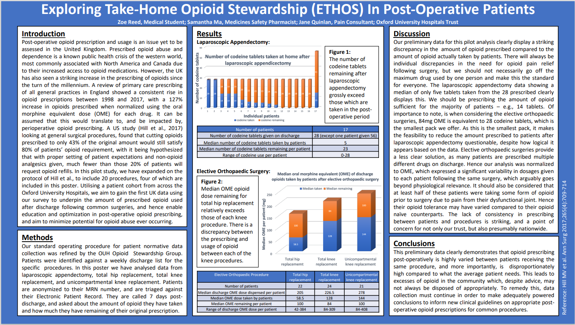

Slide 5
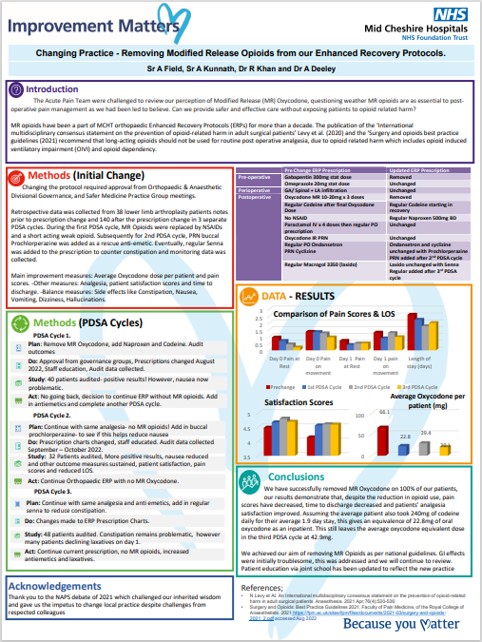

Slide 6
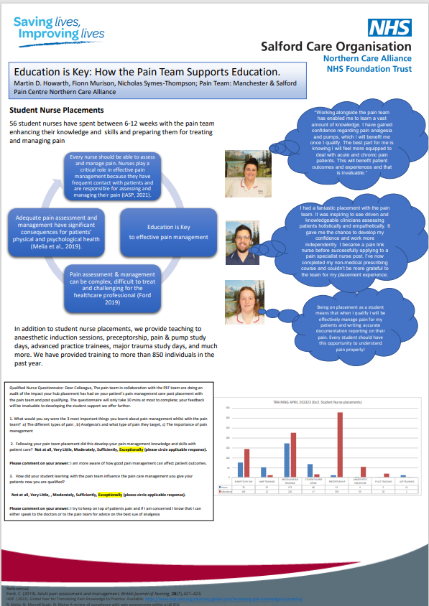

Slide 7
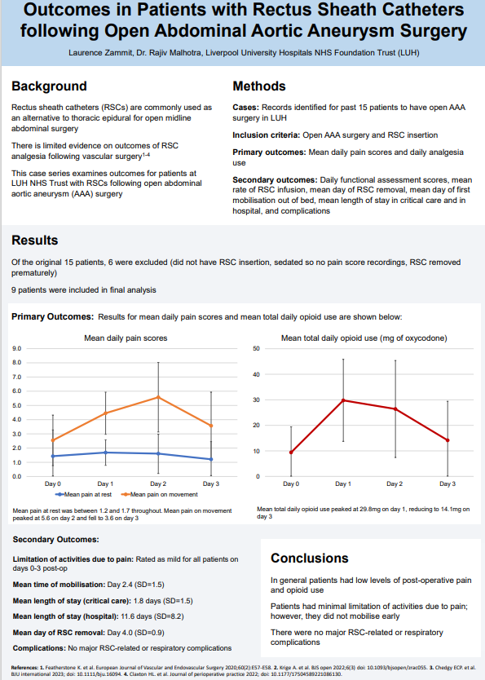

Slide 8
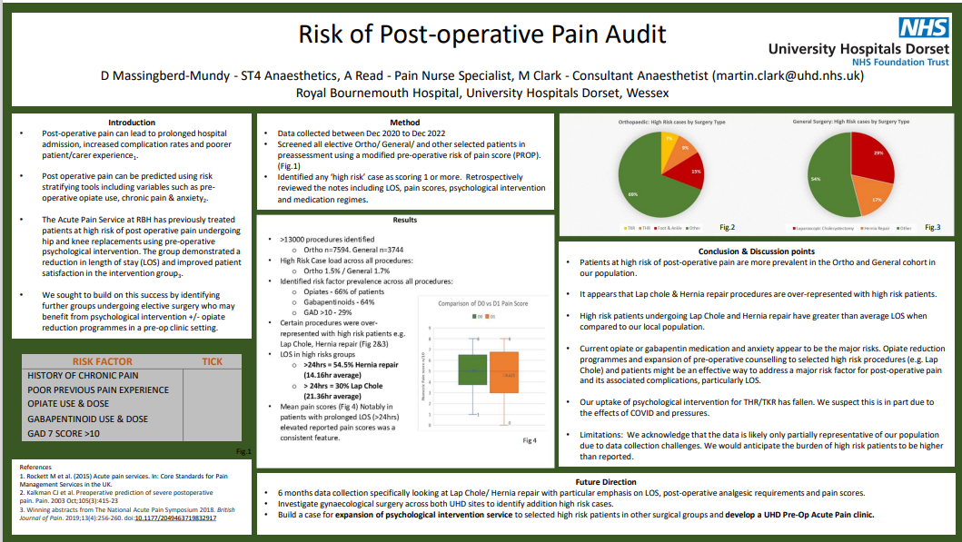

Slide 9
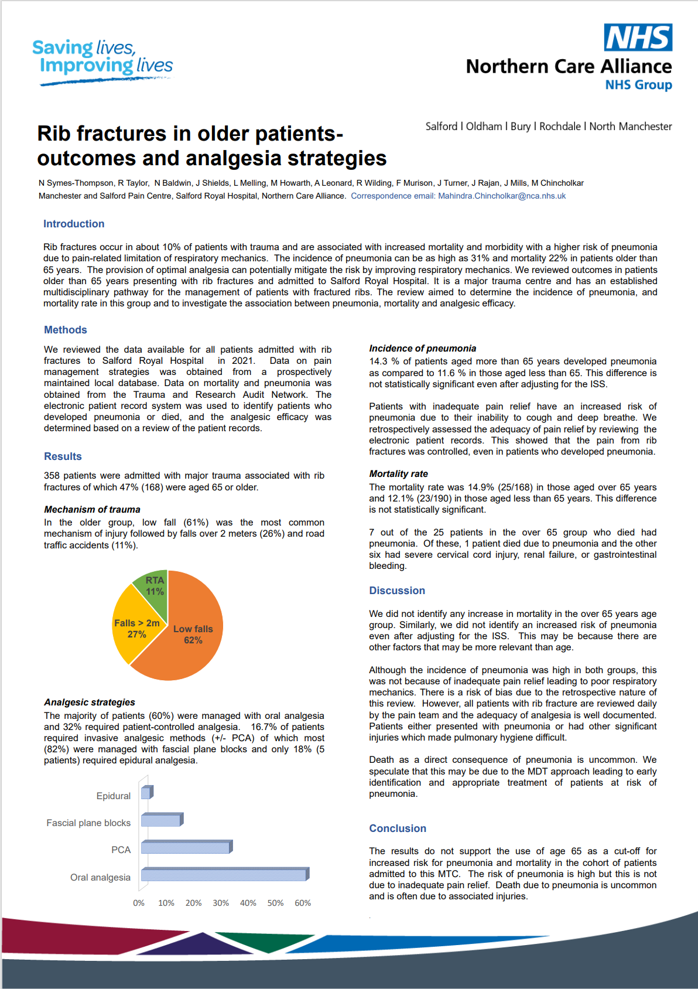

Slide 10
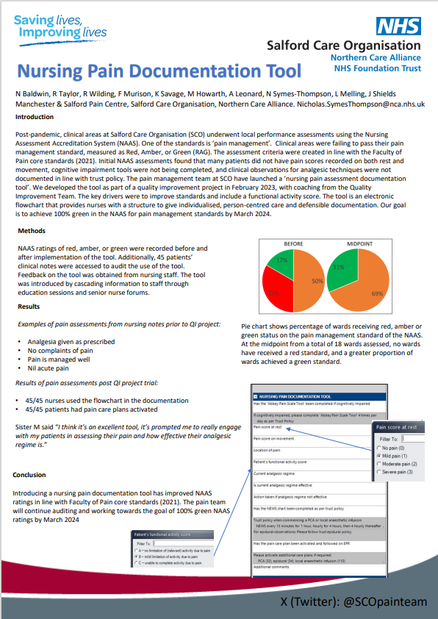

Slide 11
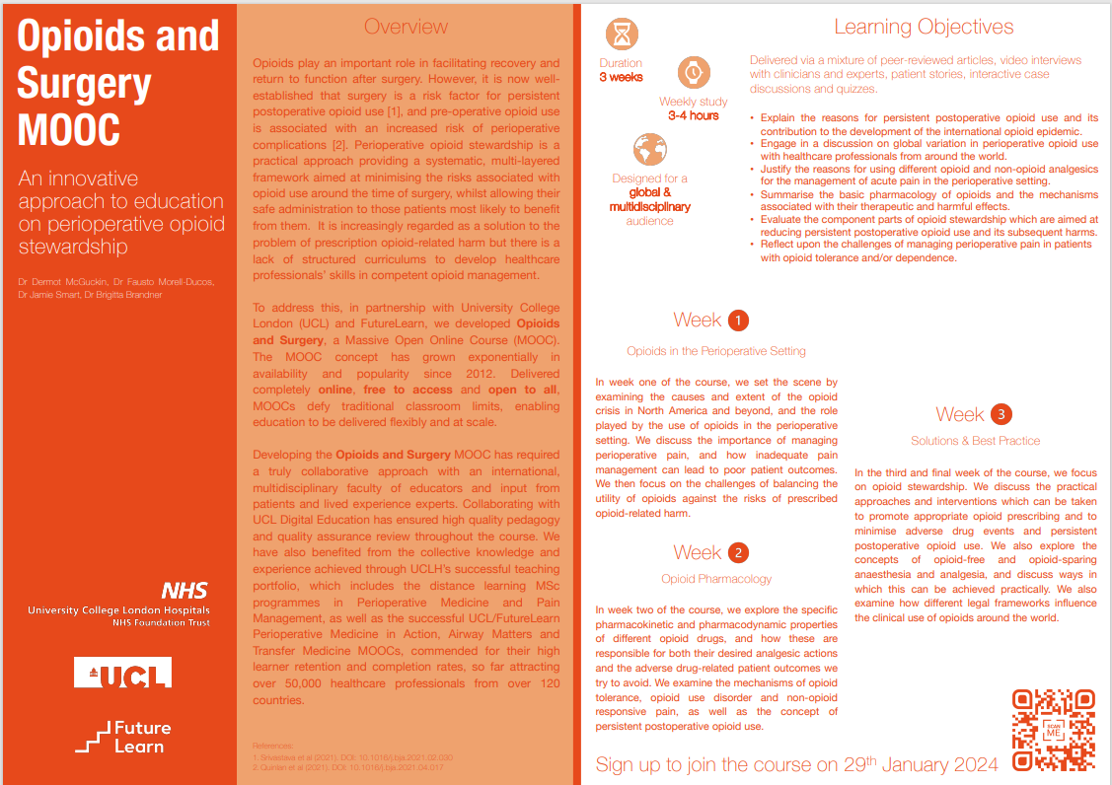

Slide 12
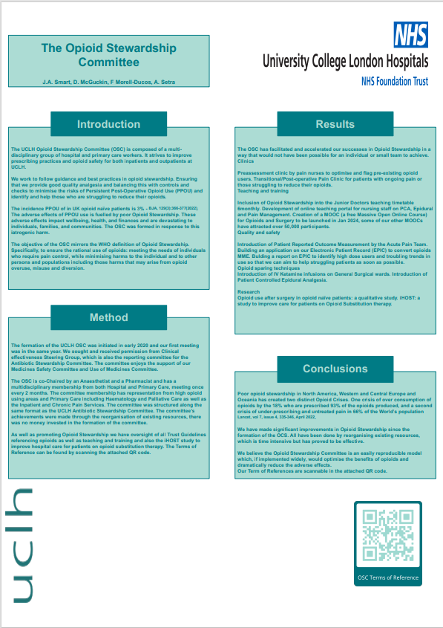

Slide 13
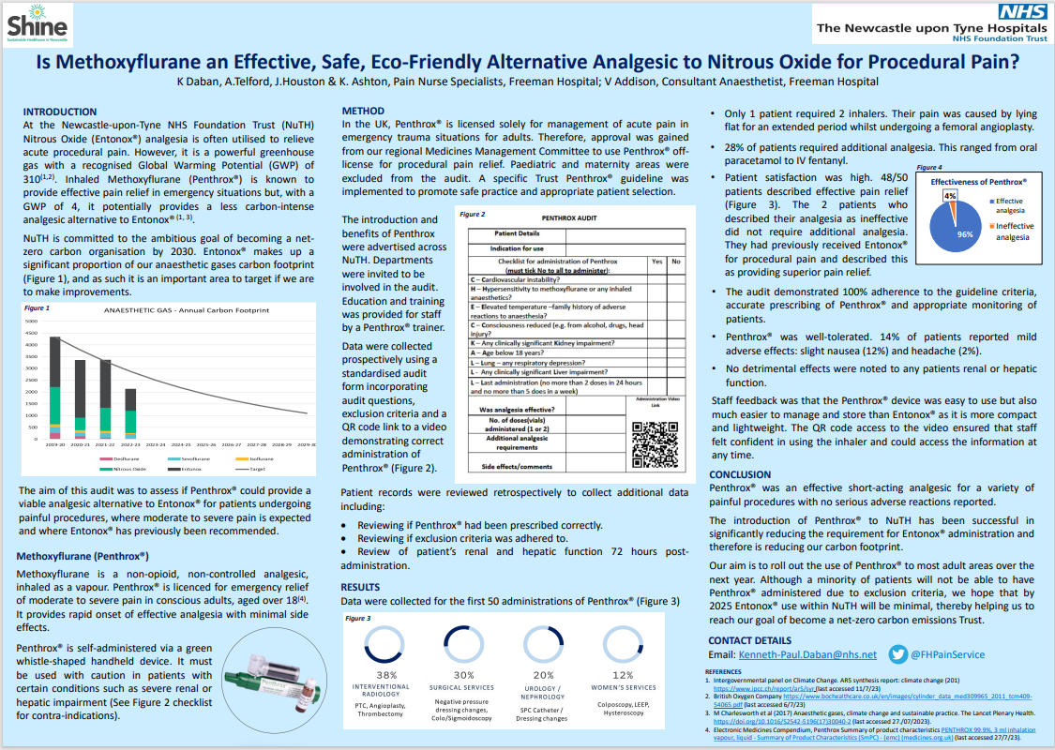

Slide 14
